Slide 1


Slide 2


Slide 3
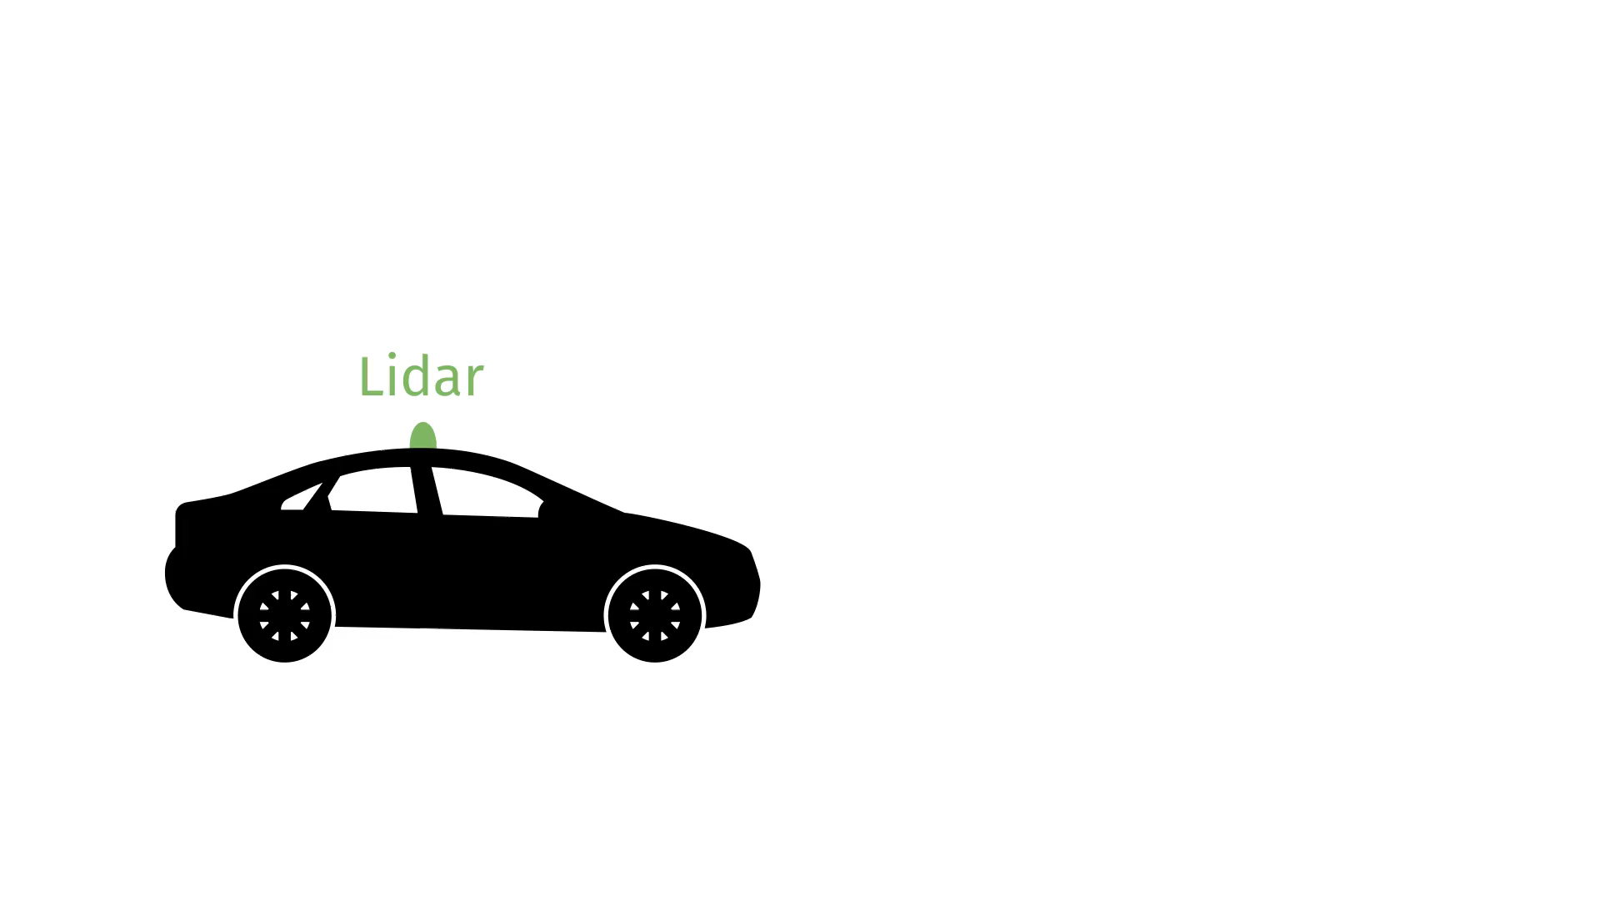

Slide 4


Slide 6


Slide 7


Slide 8


Slide 9


Slide 10


Slide 11

Set of objects in an image

Slide 12
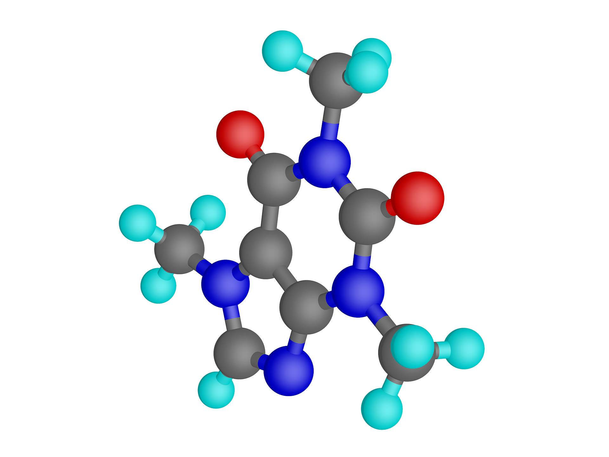
Set of atoms in a molecule

Slide 13
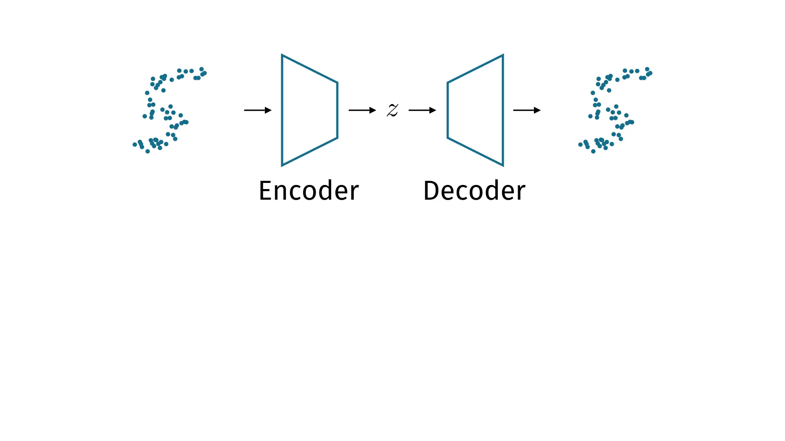
Overview
Parts of this talk:
Set encoders: set → vector
Set decoders: vector → set

Slide 14
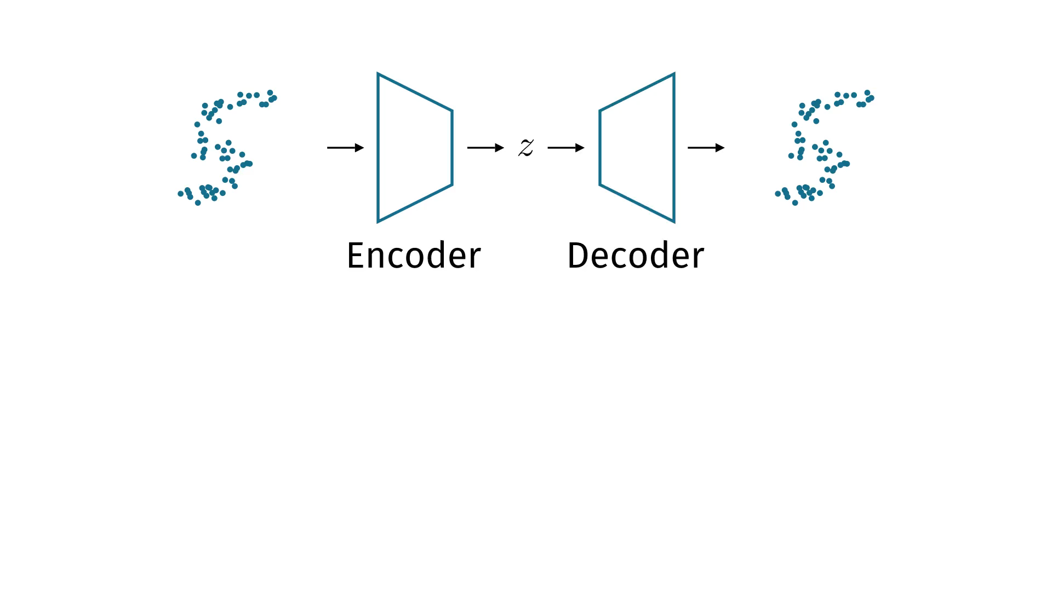
Overview
Parts of this talk:
Set encoders: set → vector
Set decoders: vector → set

Slide 15
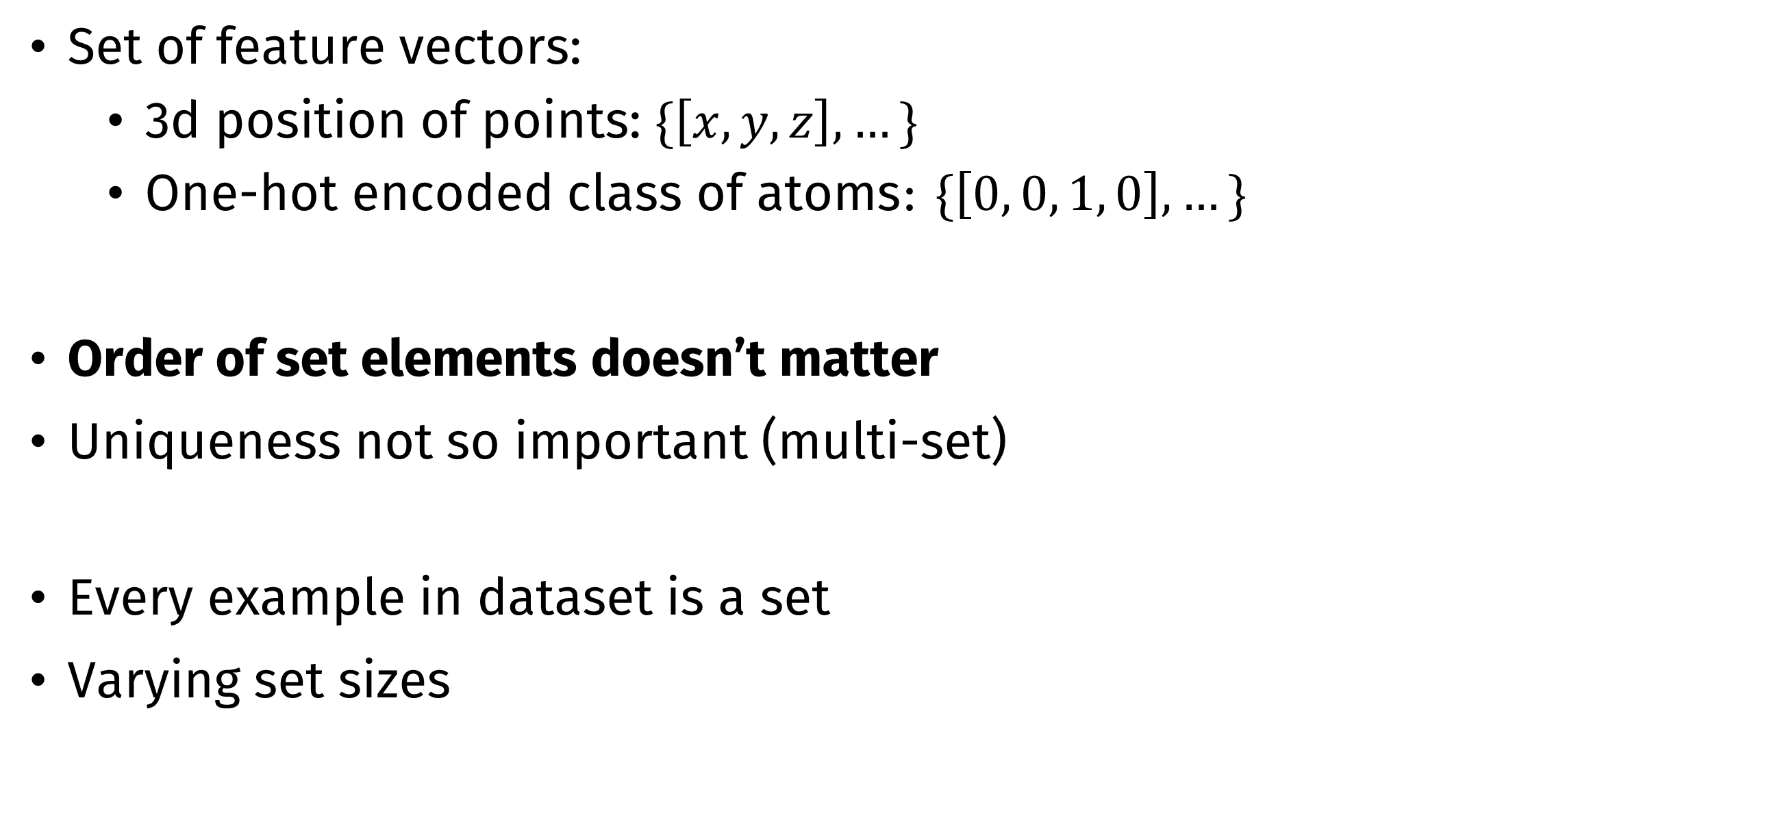
What is a set?
Set of feature vectors:
3d position of points: $\{\left[x, y, z\right], …\}$
One-hot encoded class of atoms: $\{\left[0, 0, 1, 0\right], …\}$
Order of set elements doesn’t matter
Uniqueness not so important (multi-set)
Every example in dataset is a set
Varying set sizes

Slide 16
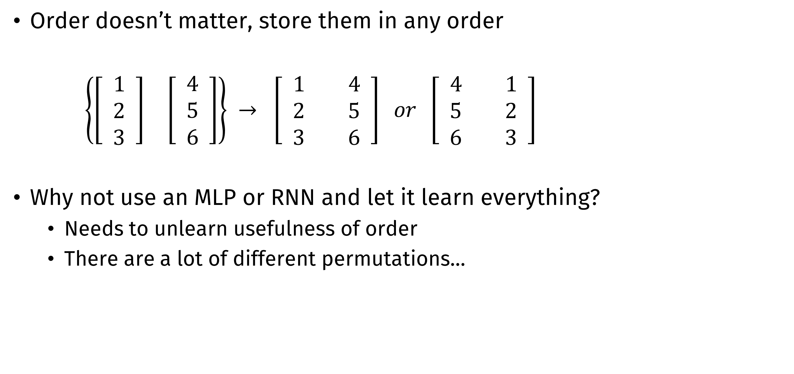
Working with sets
Order doesn’t matter, store them in any order
$\left\{\begin{matrix}\left[\begin{matrix} 1 \\ 2 \\ 3\end{matrix}\right] & \left[ \begin{matrix} 4 \\ 5 \\ 6 \end{matrix}\right]\end{matrix}\right\} → \left[\begin{matrix} 1 & 4 \\ 2 & 5 \\ 3 & 6\end{matrix}\right] or \left[\begin{matrix} 4 & 1 \\ 5 & 2 \\ 6 & 3\end{matrix}\right]$
Why not use an MLP or RNN and let it learn everything?
Needs to unlearn usefulness of order
There are a lot of different permutations...

Slide 17
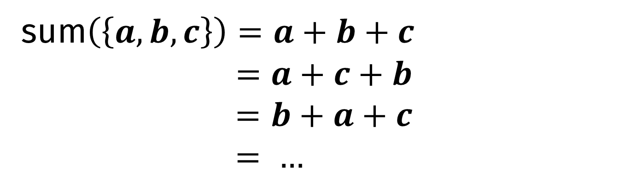
Properties 1 (Zaheer et al.)
Permutation invariance
Permutations of the input don’t change the output
Summing is permutation-invariant
Averaging is permutation-invariant
Can you think of other permutation-invariant functions?
sum$\left(\left\{a, b, c\right\}\right)=a+b+c$ $$=a+c+b \\ =b+a+c \\ = …$$

Slide 18

Properties 2 (Zaheer et al.)
Permutation equivariance
Permutations of the input change the permutation of the
output predictably
Apply the same neural network to every element
Concatenate the same feature vector to every element
Self-attention
$$\left\{a, b, c\right\}→\{f\left(a\right), f\left(b\right), f(c)\}$$
$$\left\{b, a, c\right\}→\{f\left(b\right), f\left(a\right), f(c)\}$$

Slide 19
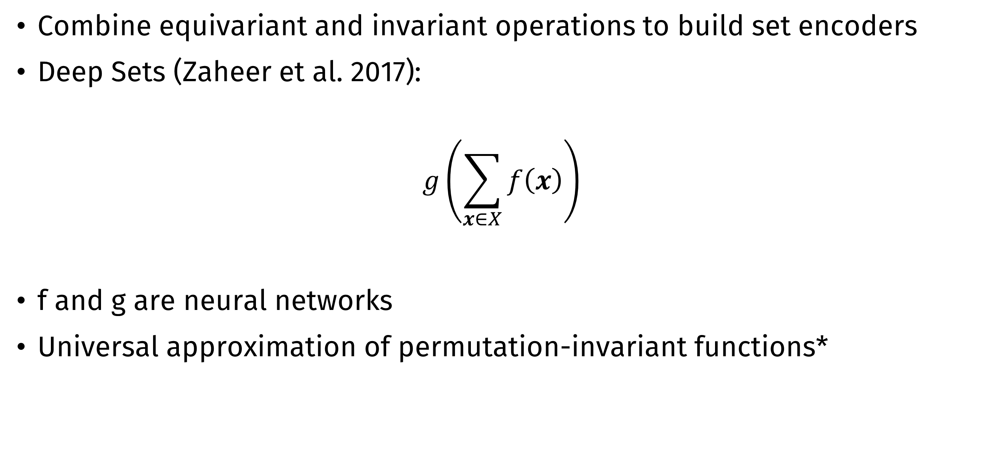
Building set encoders
Combine equivariant and invariant operations to build set encoders
Deep Sets (Zaheer et al. 2017):
$$g\left(\sum_{x∈X}{f\left(x\right)}\right)$$
f and g are neural networks
Universal approximation of permutation-invariant functions*

Slide 20
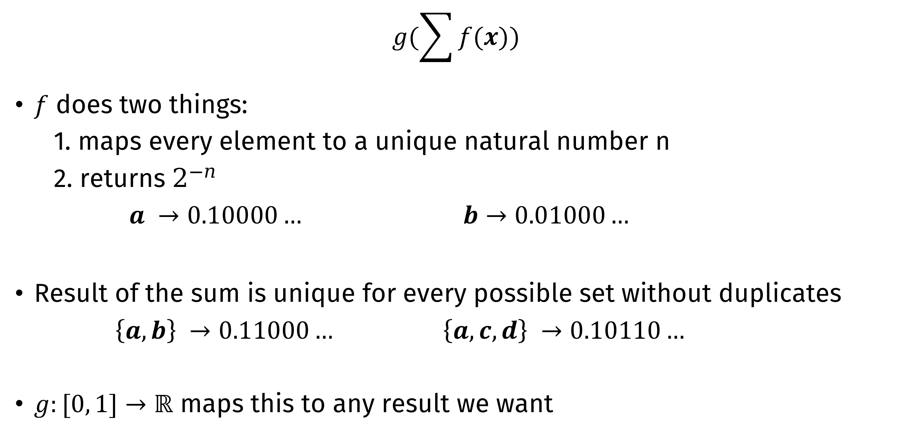
Universal approximation sketch
$$g(\sum{f(x)})$$
$f$ does two things:
1. maps every element to a unique natural number n
2. returns $2^{−n}$
$a →0.10000…$ $b→0.01000…$
Result of the sum is unique for every possible set without duplicates
$\left\{a, b\right\} →0.11000…$ $\left\{a, c, d\right\} →0.10110…$
$g:[0, 1]→ℝ$ maps this to any result we want

Slide 21
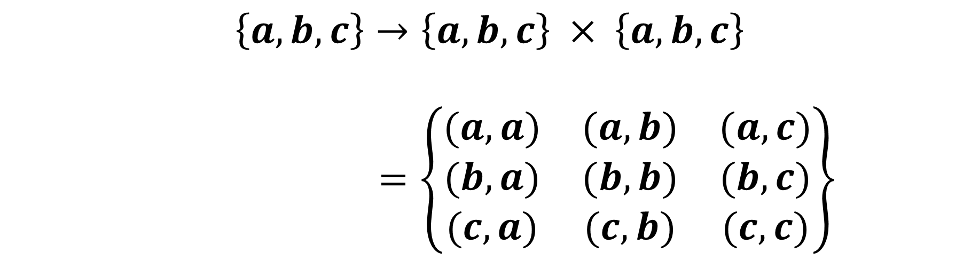
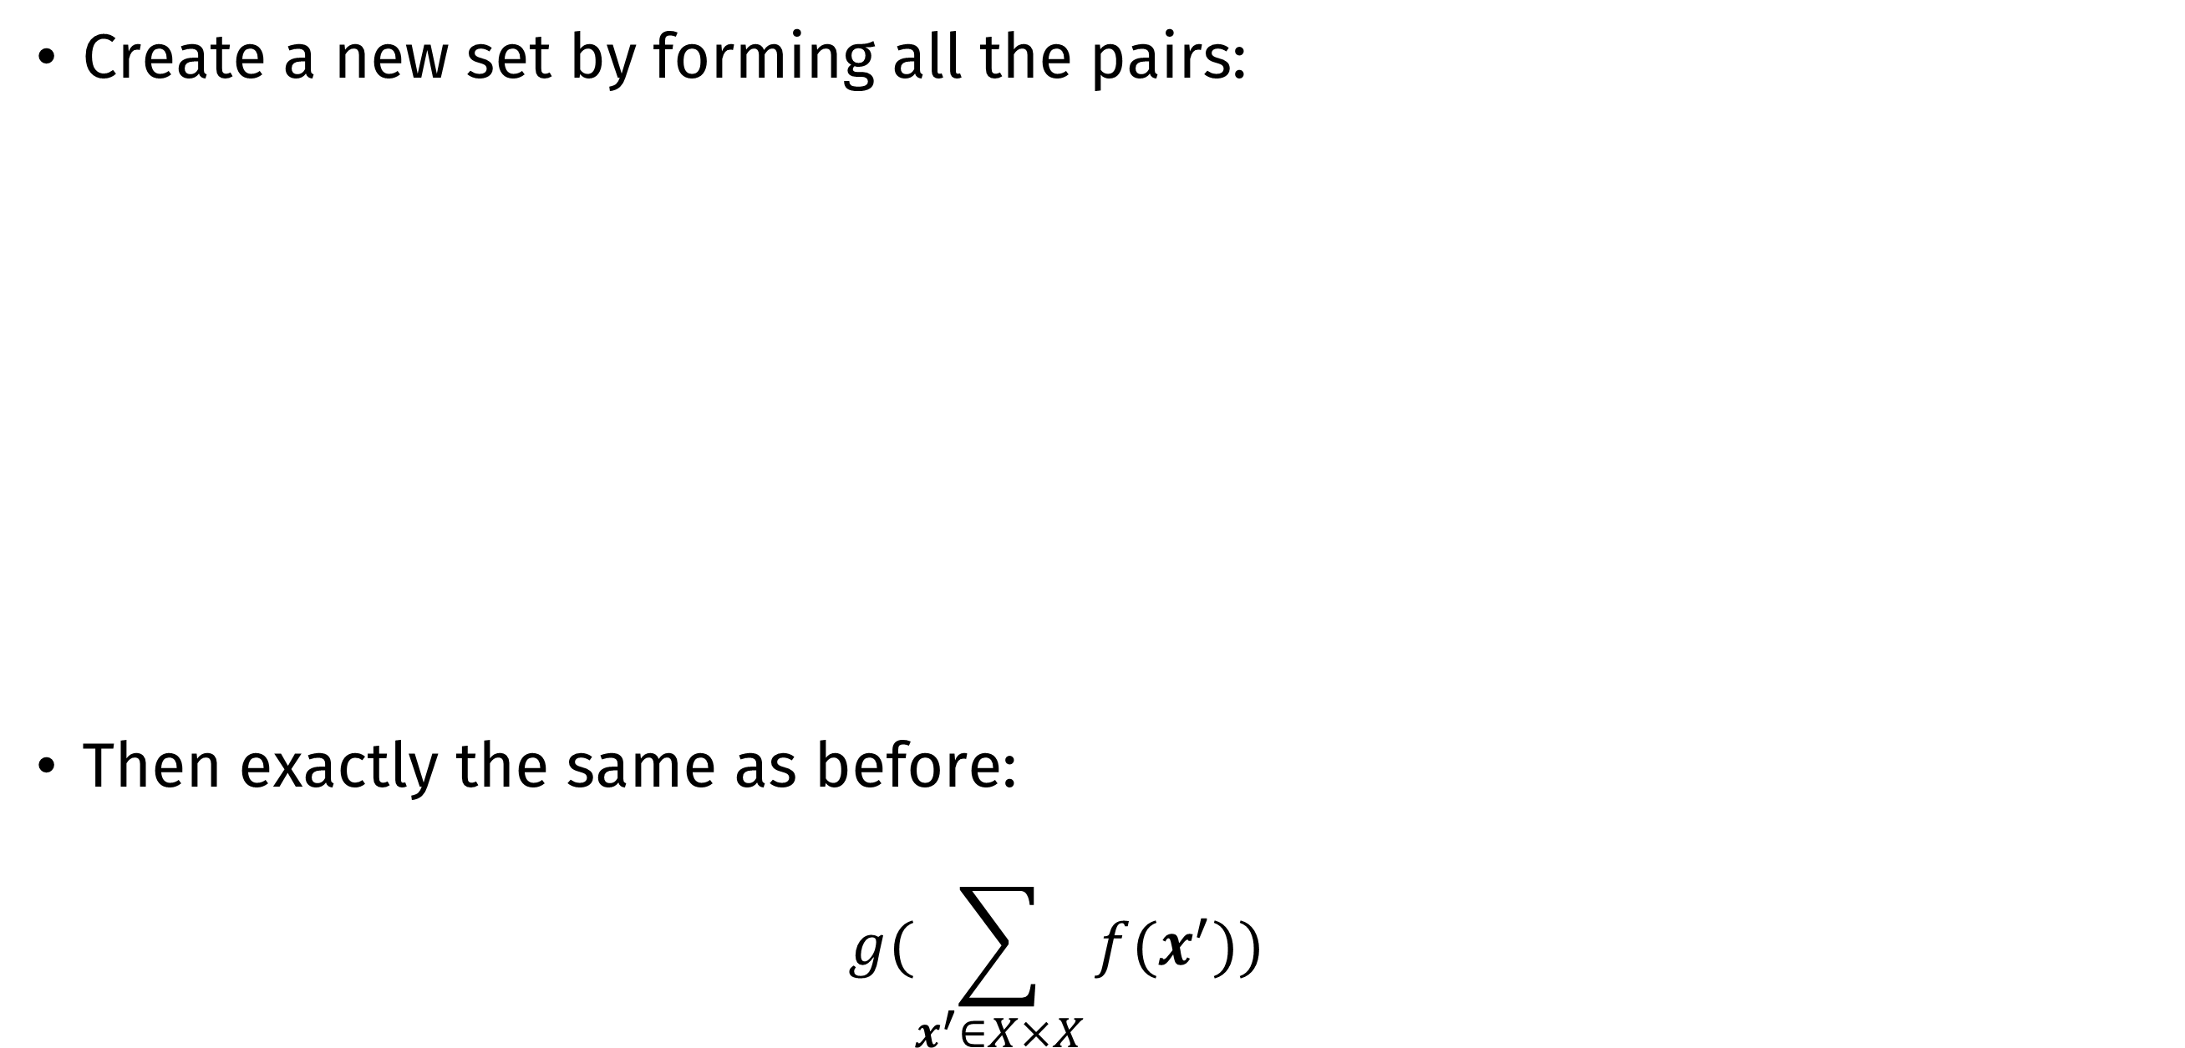
Relation Networks (Santoro et al. 2017)
Create a new set by forming all the pairs:
Then exactly the same as before:
$$g(\sum_{x^{′}∈X×X}{f(x^{′})})$$
$$\left\{a, b, c\right\}→\left\{a, b, c\right\} × \left\{a, b, c\right\}$$
$=\left\{\begin{matrix}(a, a) & (a, b) & (a, c) \\ (b, a) & (b, b) & (b,c) \\ (c, a) & (c, b) & (c, c)\end{matrix}\right\}$

Slide 22
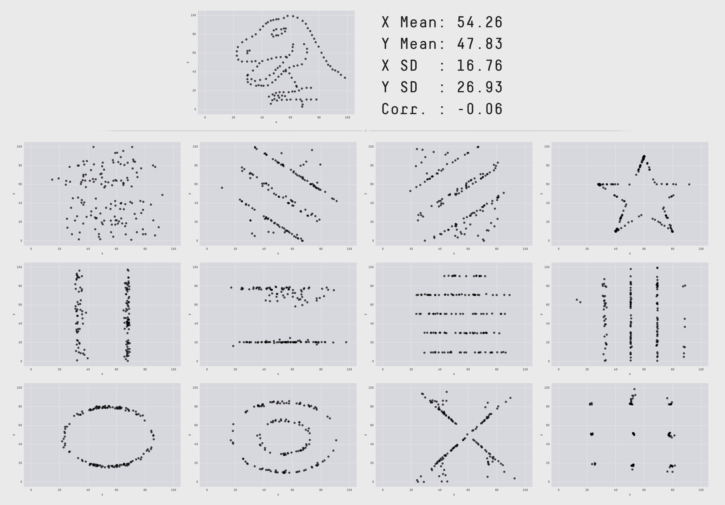

Slide 23
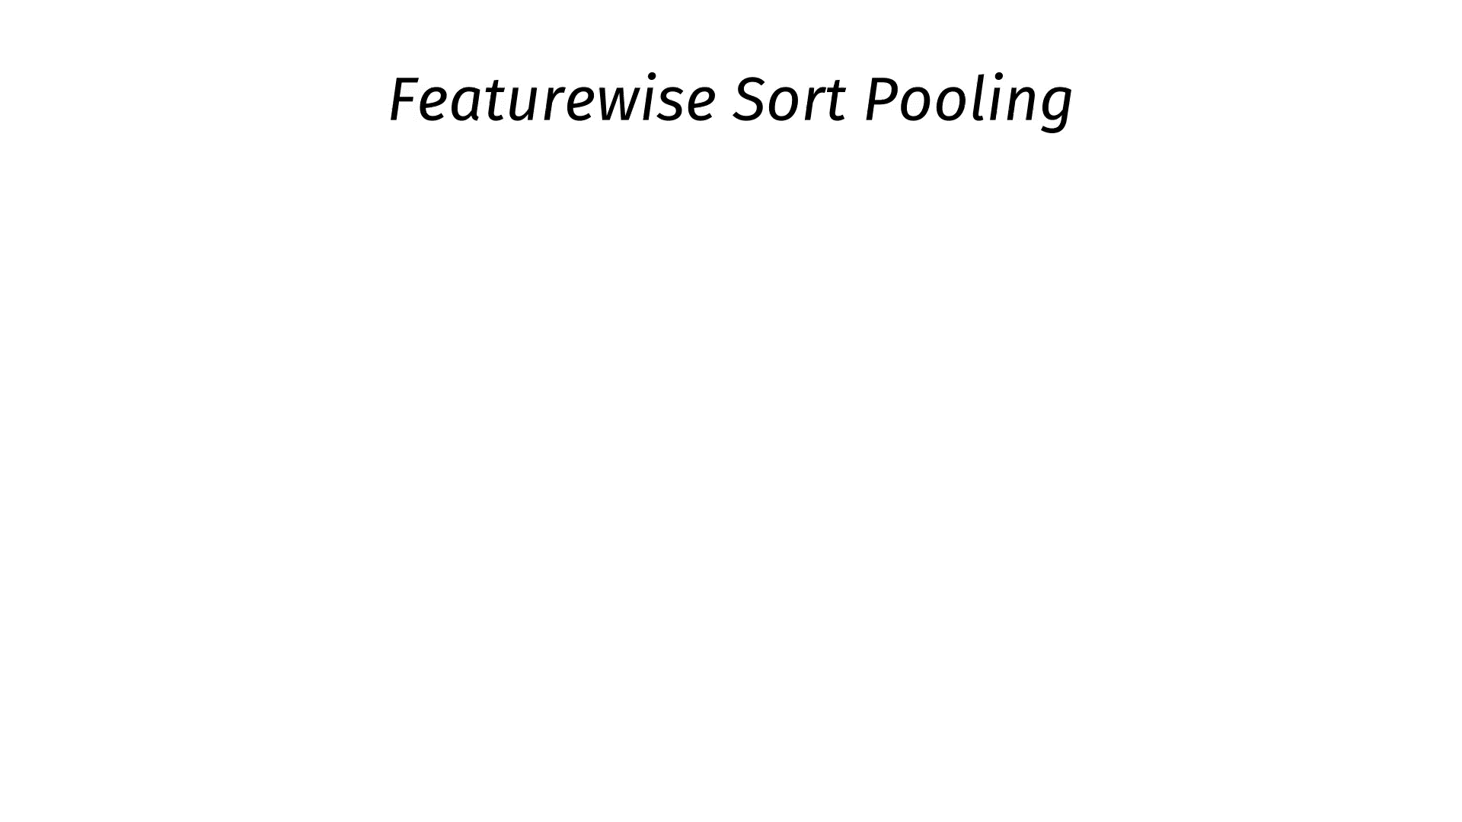

Slide 24
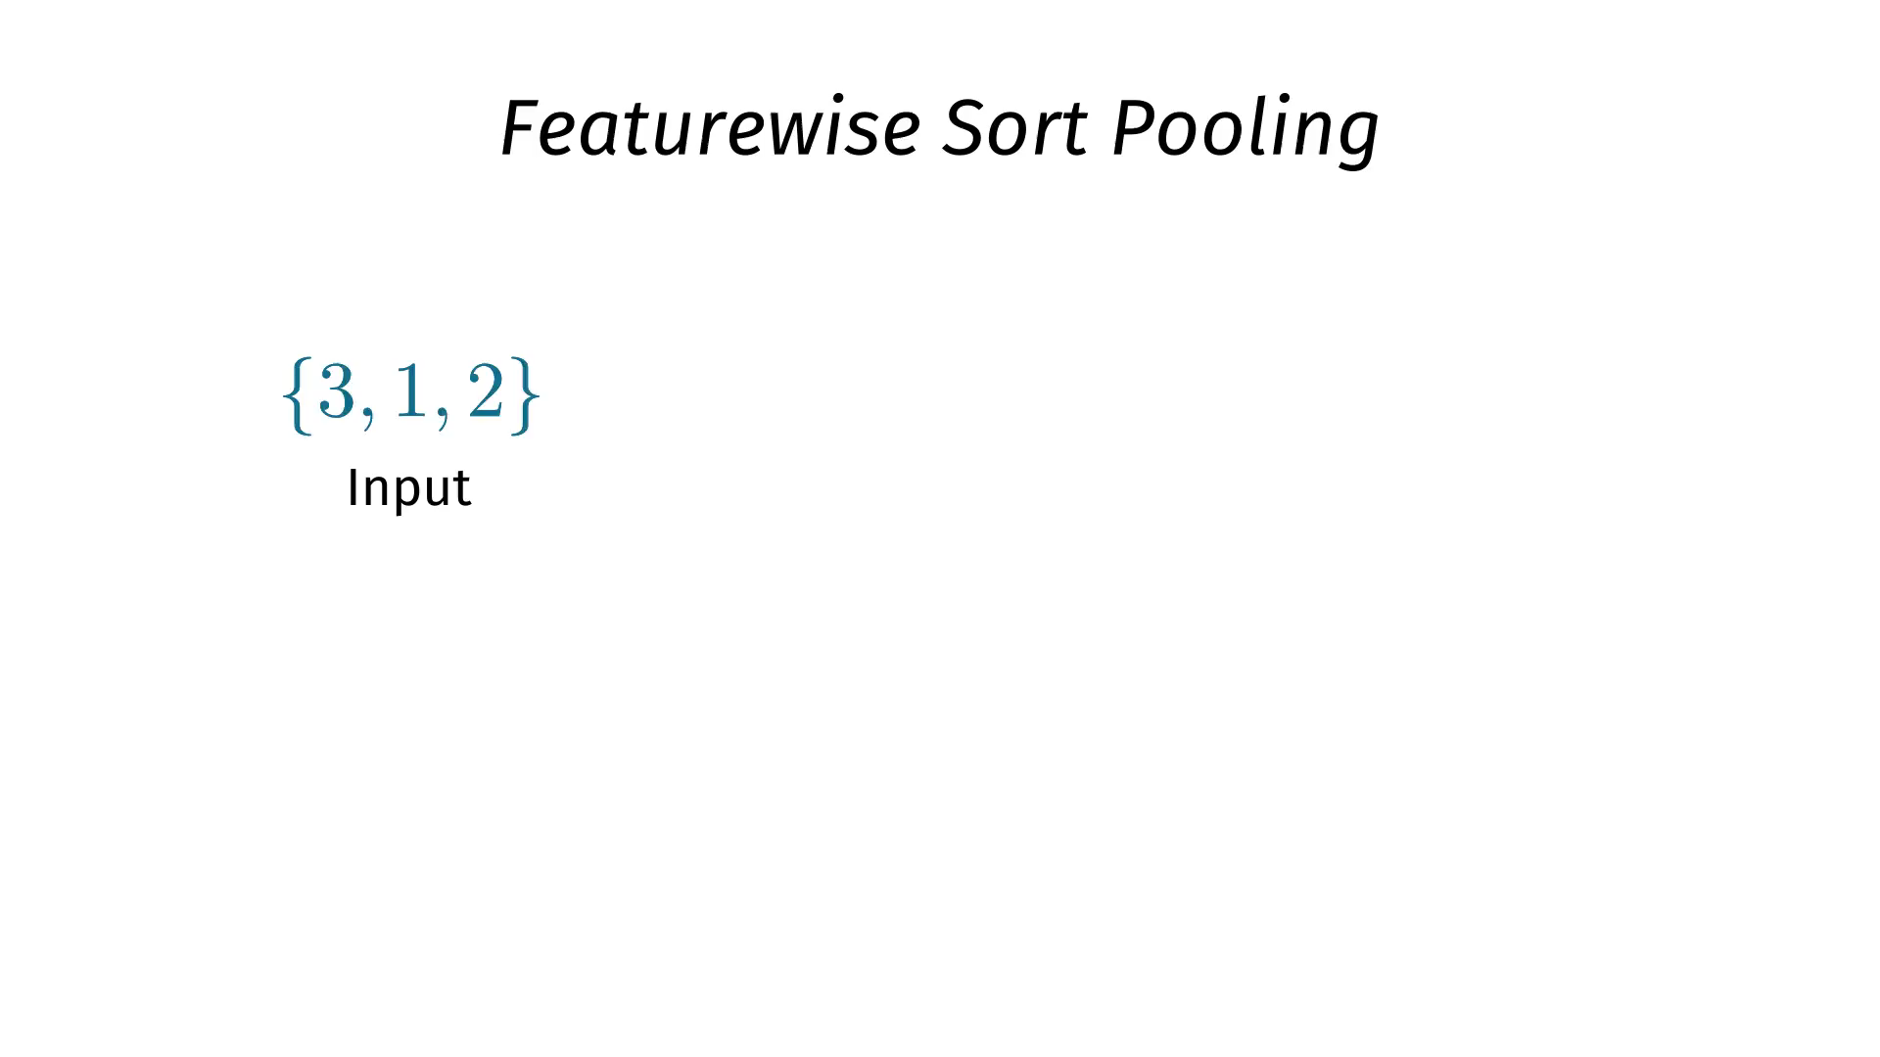

Slide 25
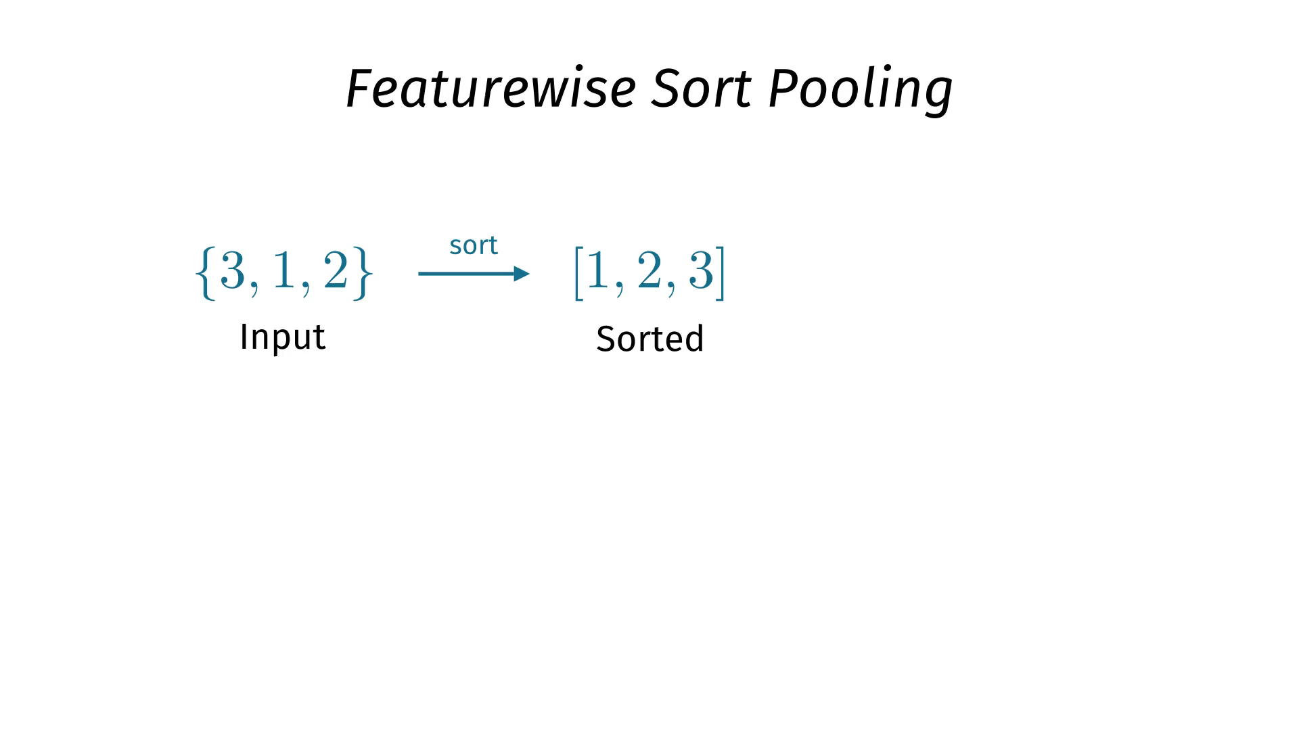

Slide 26
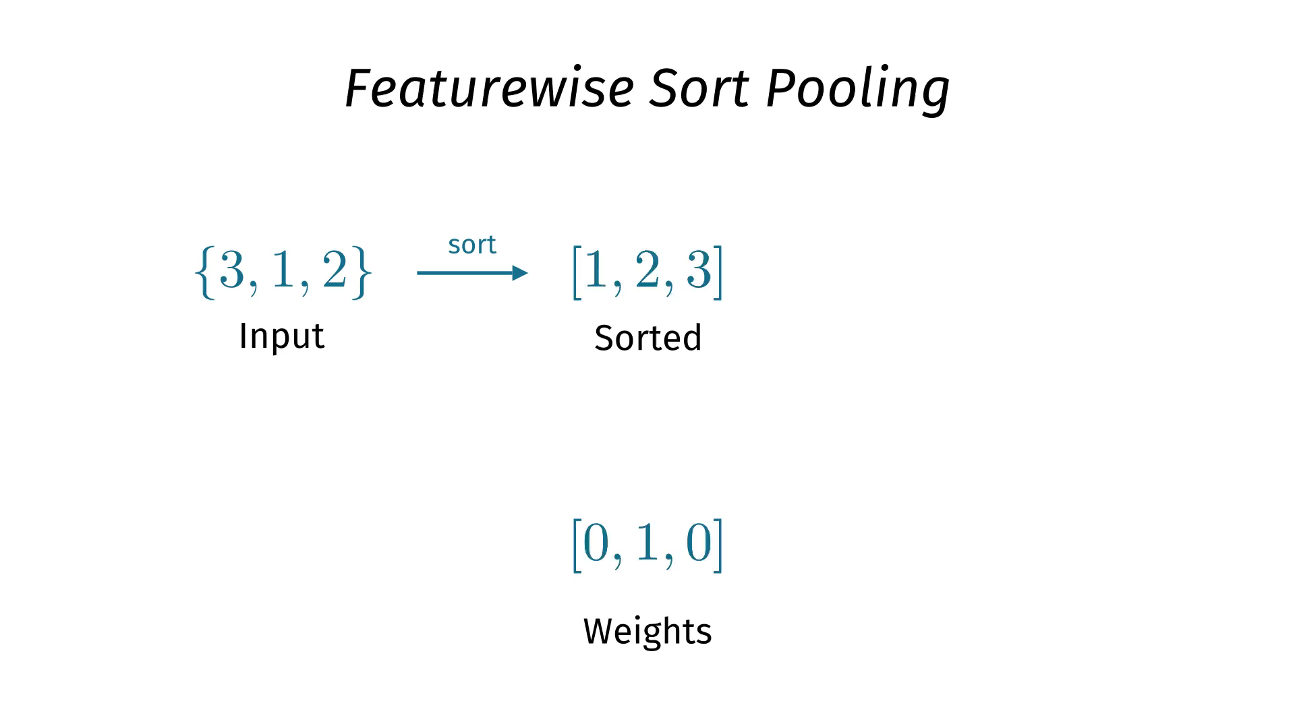

Slide 27
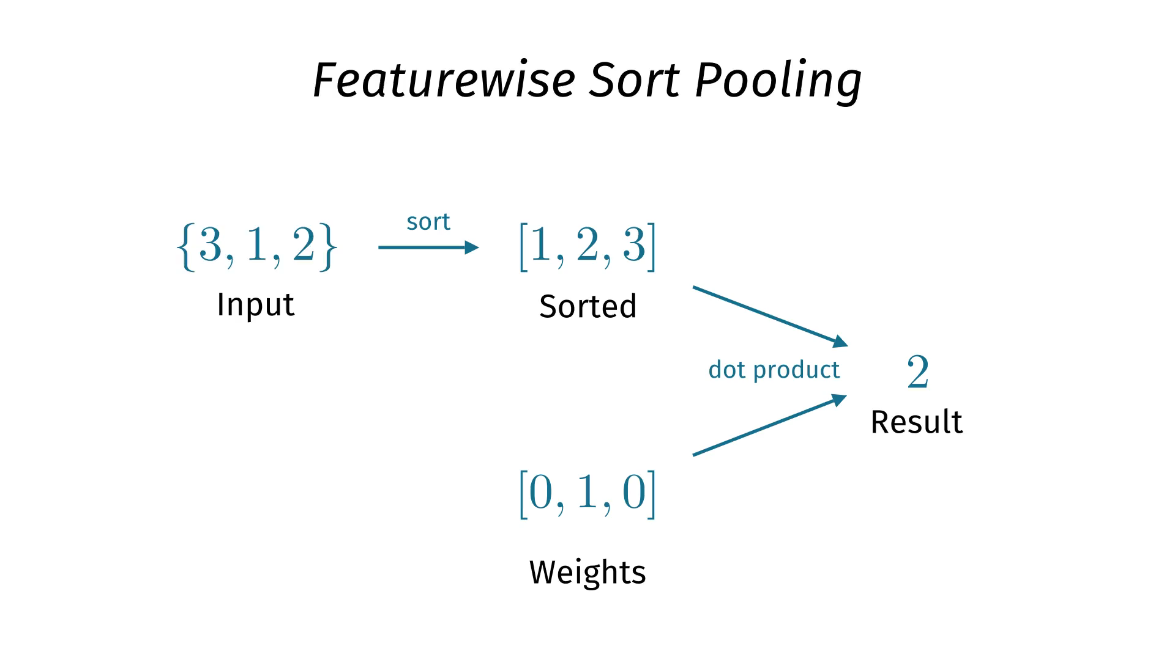

Slide 28
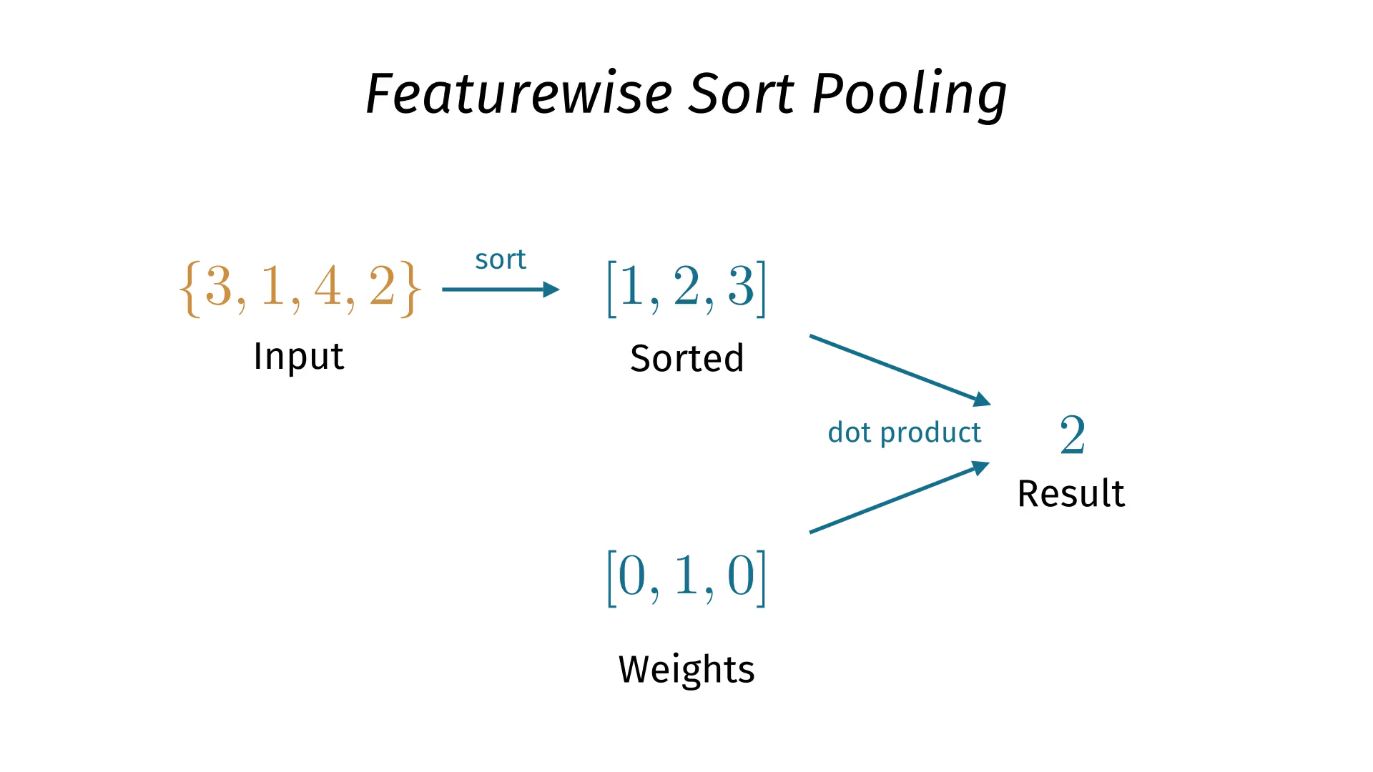

Slide 29
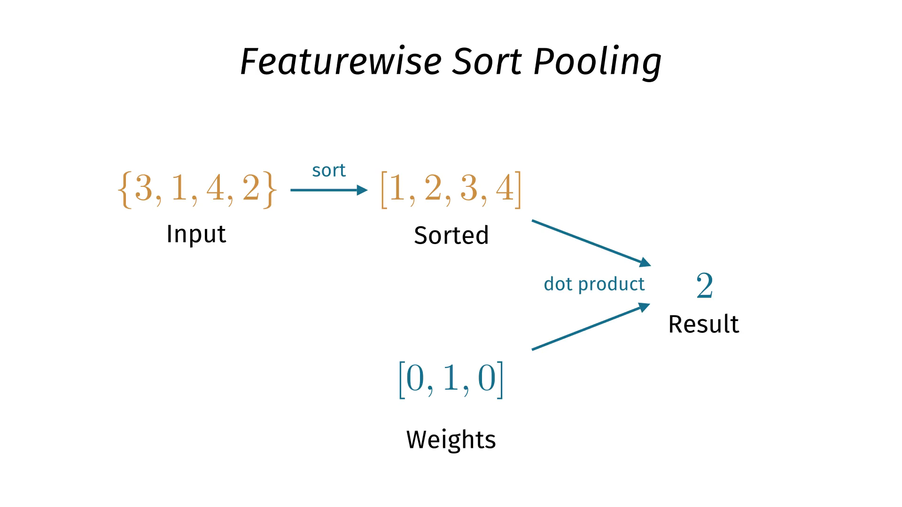

Slide 30
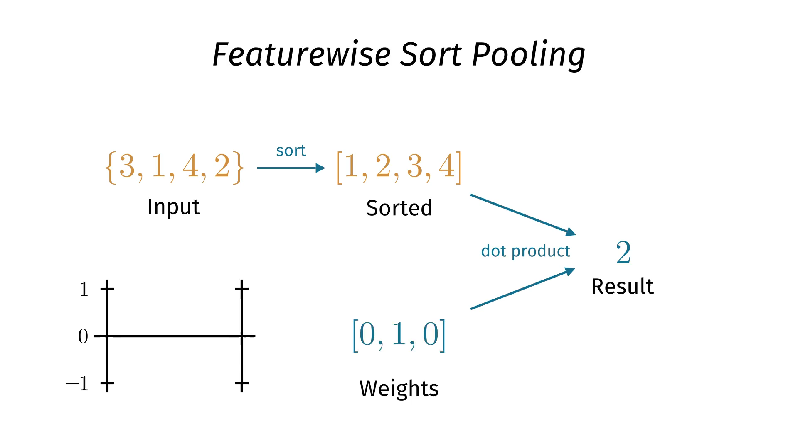

Slide 31
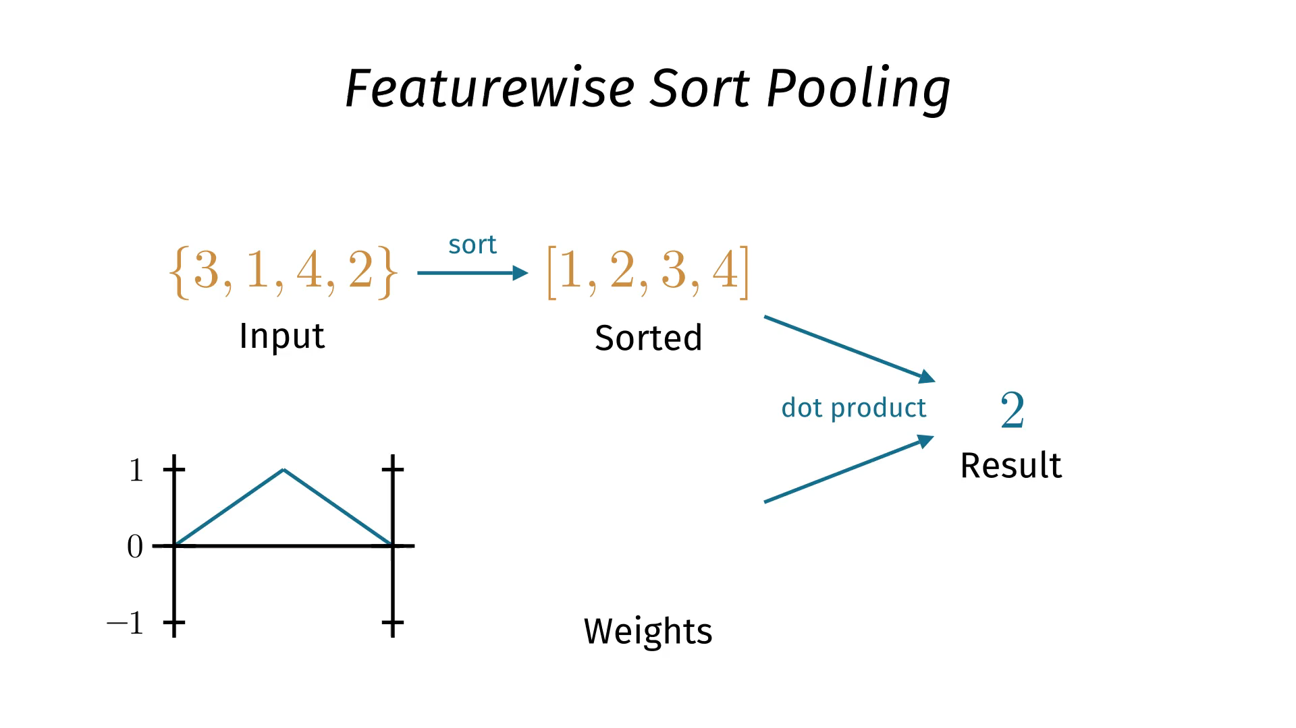

Slide 32
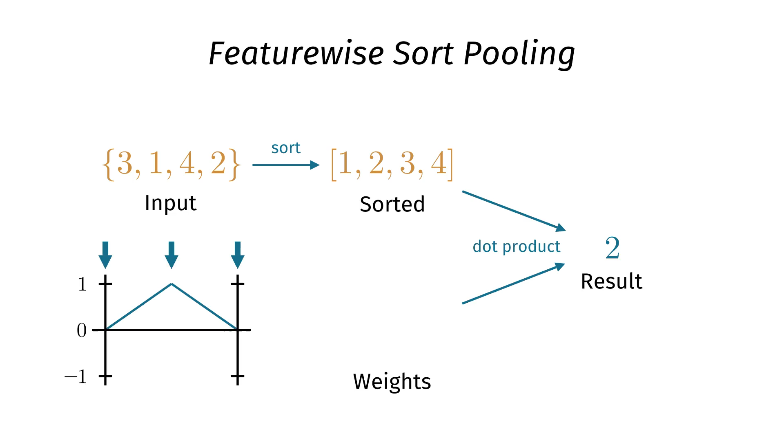

Slide 33
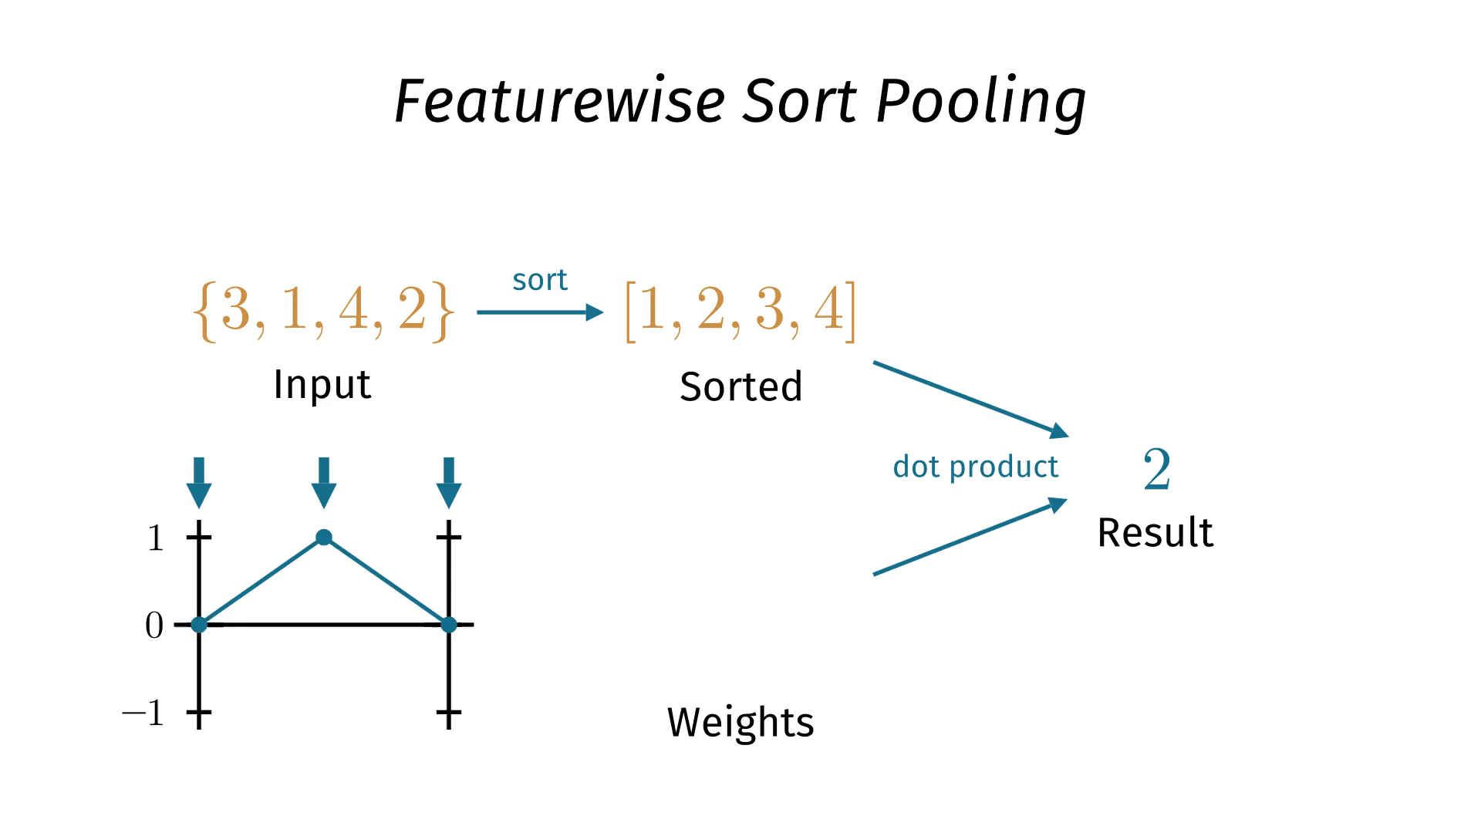

Slide 34
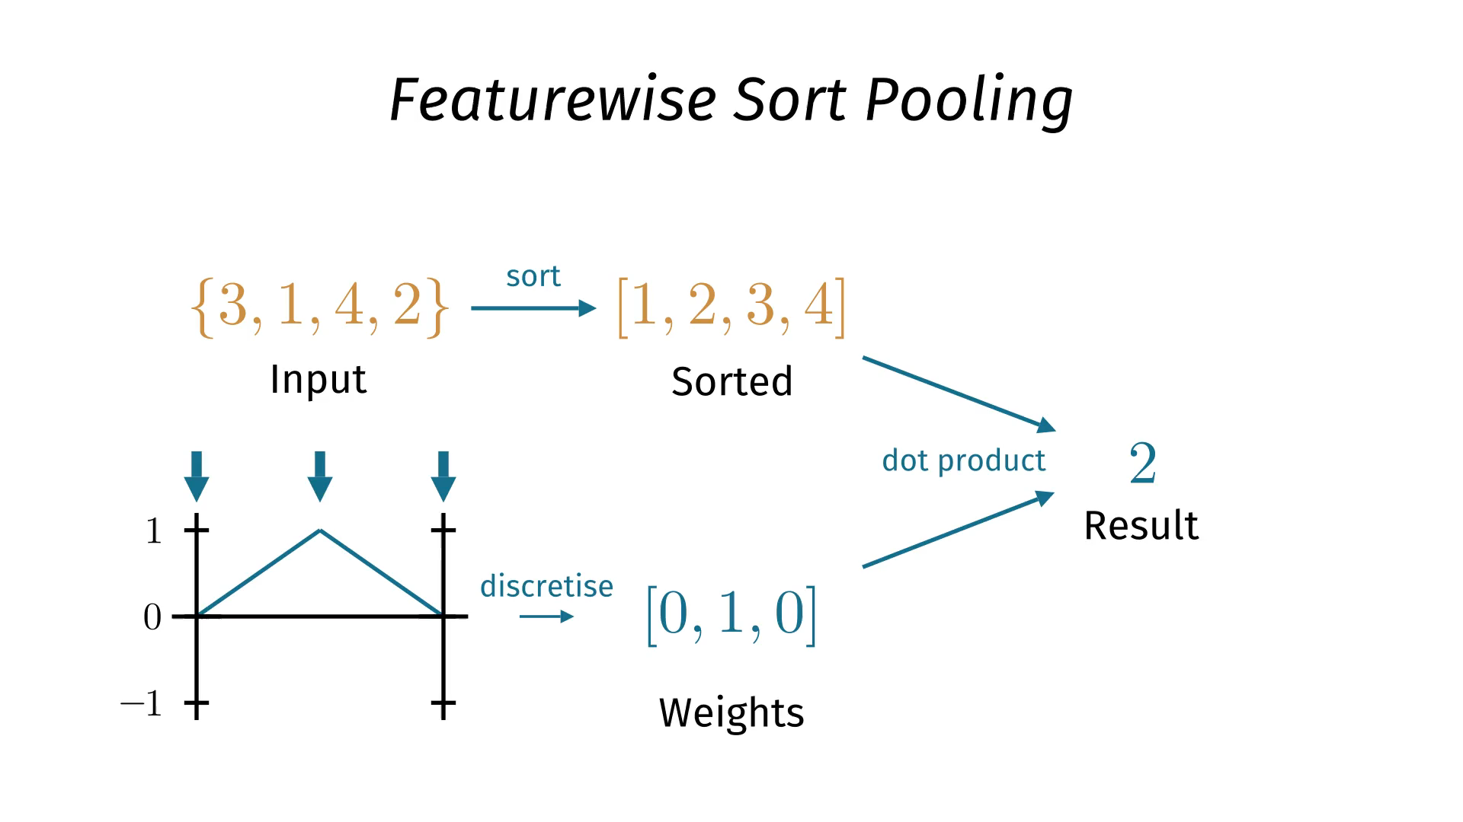

Slide 35
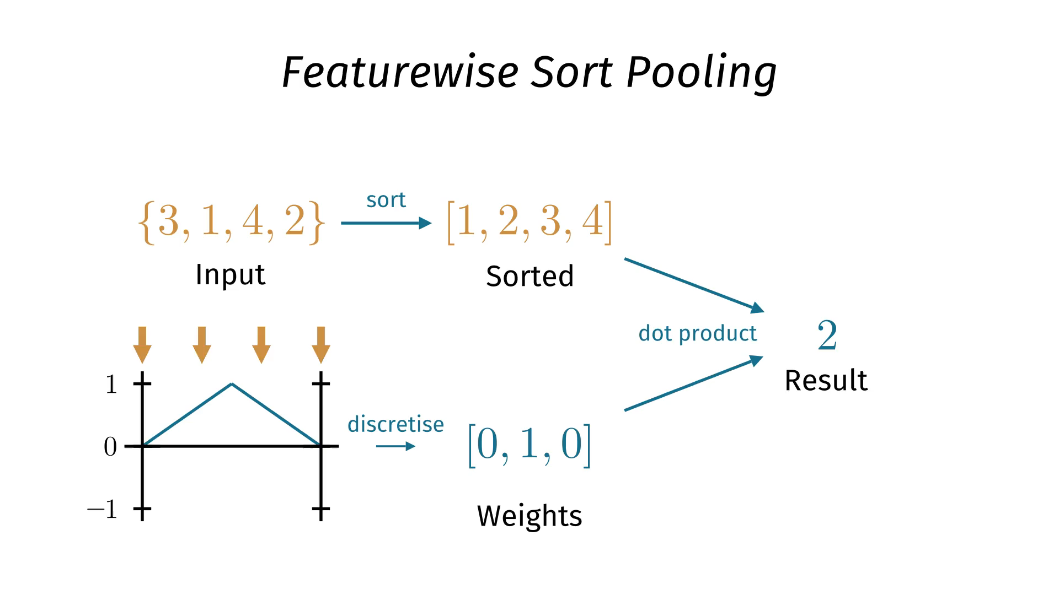

Slide 36
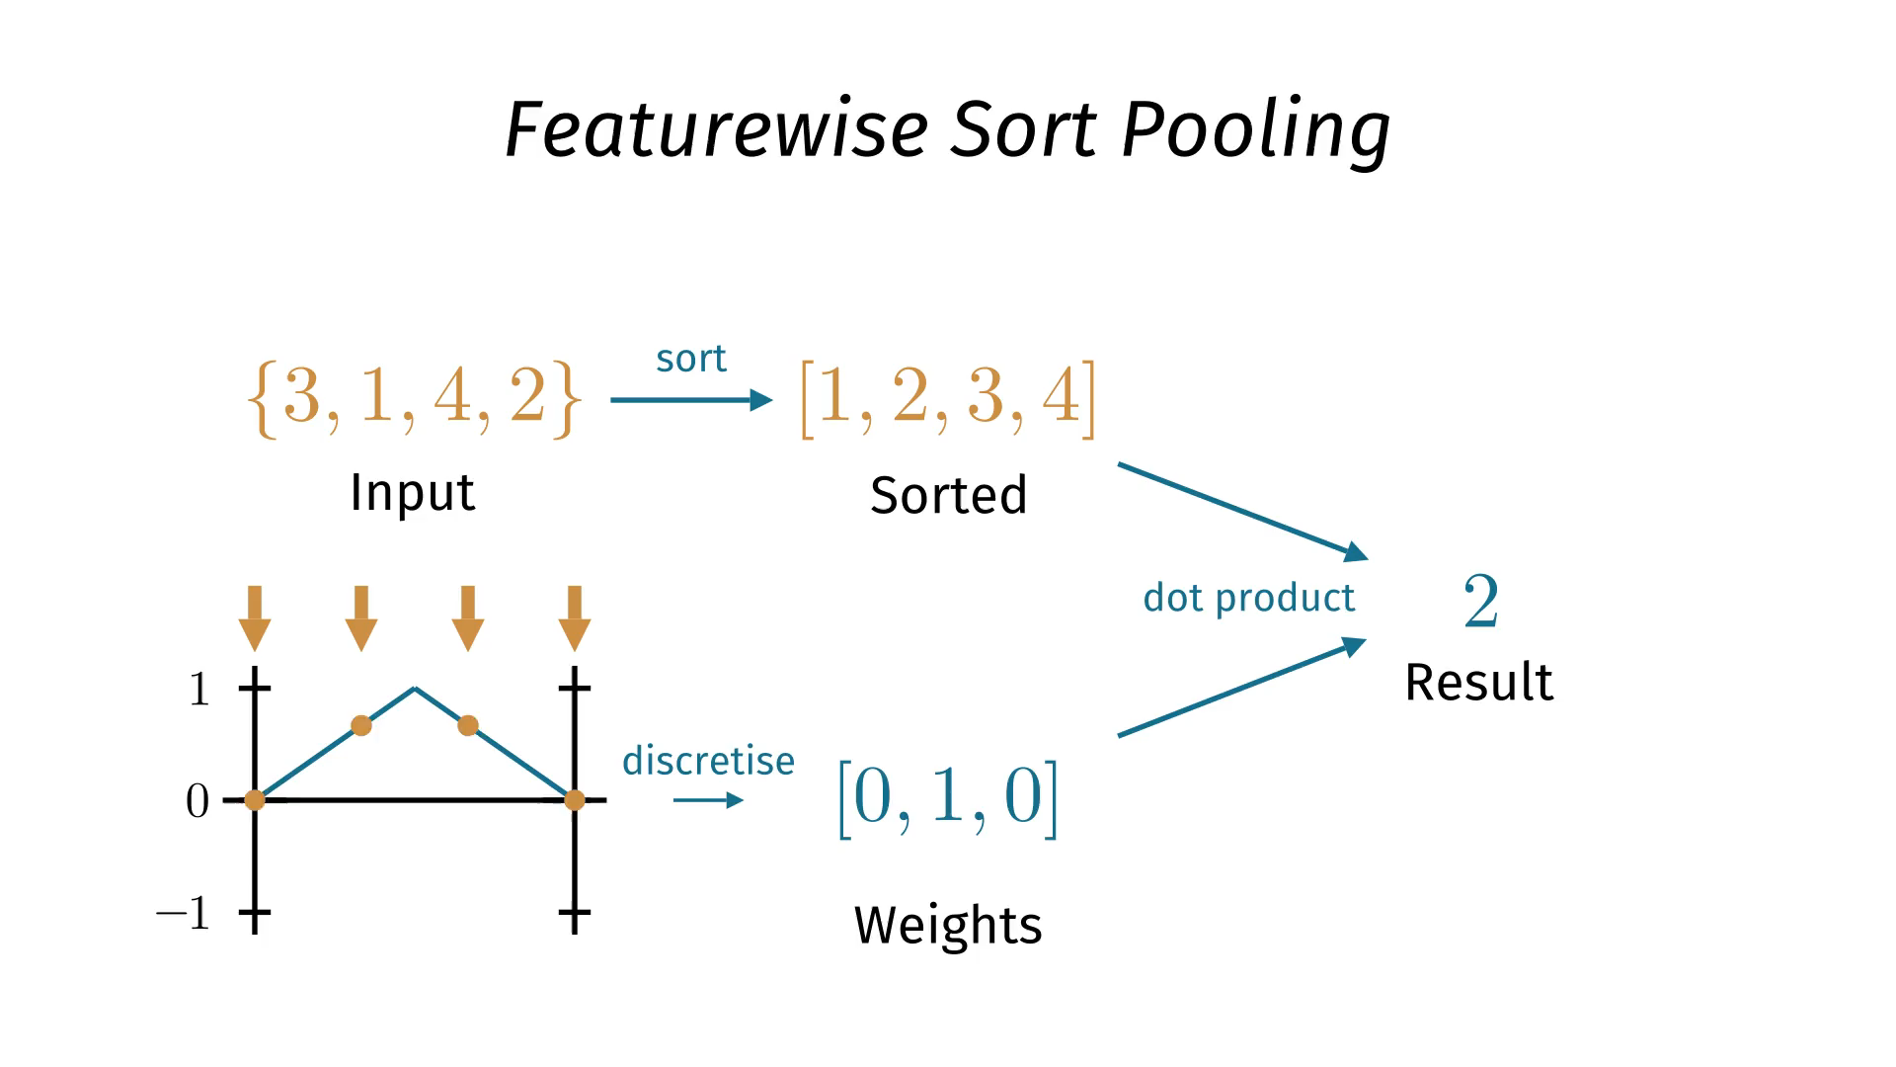

Slide 37
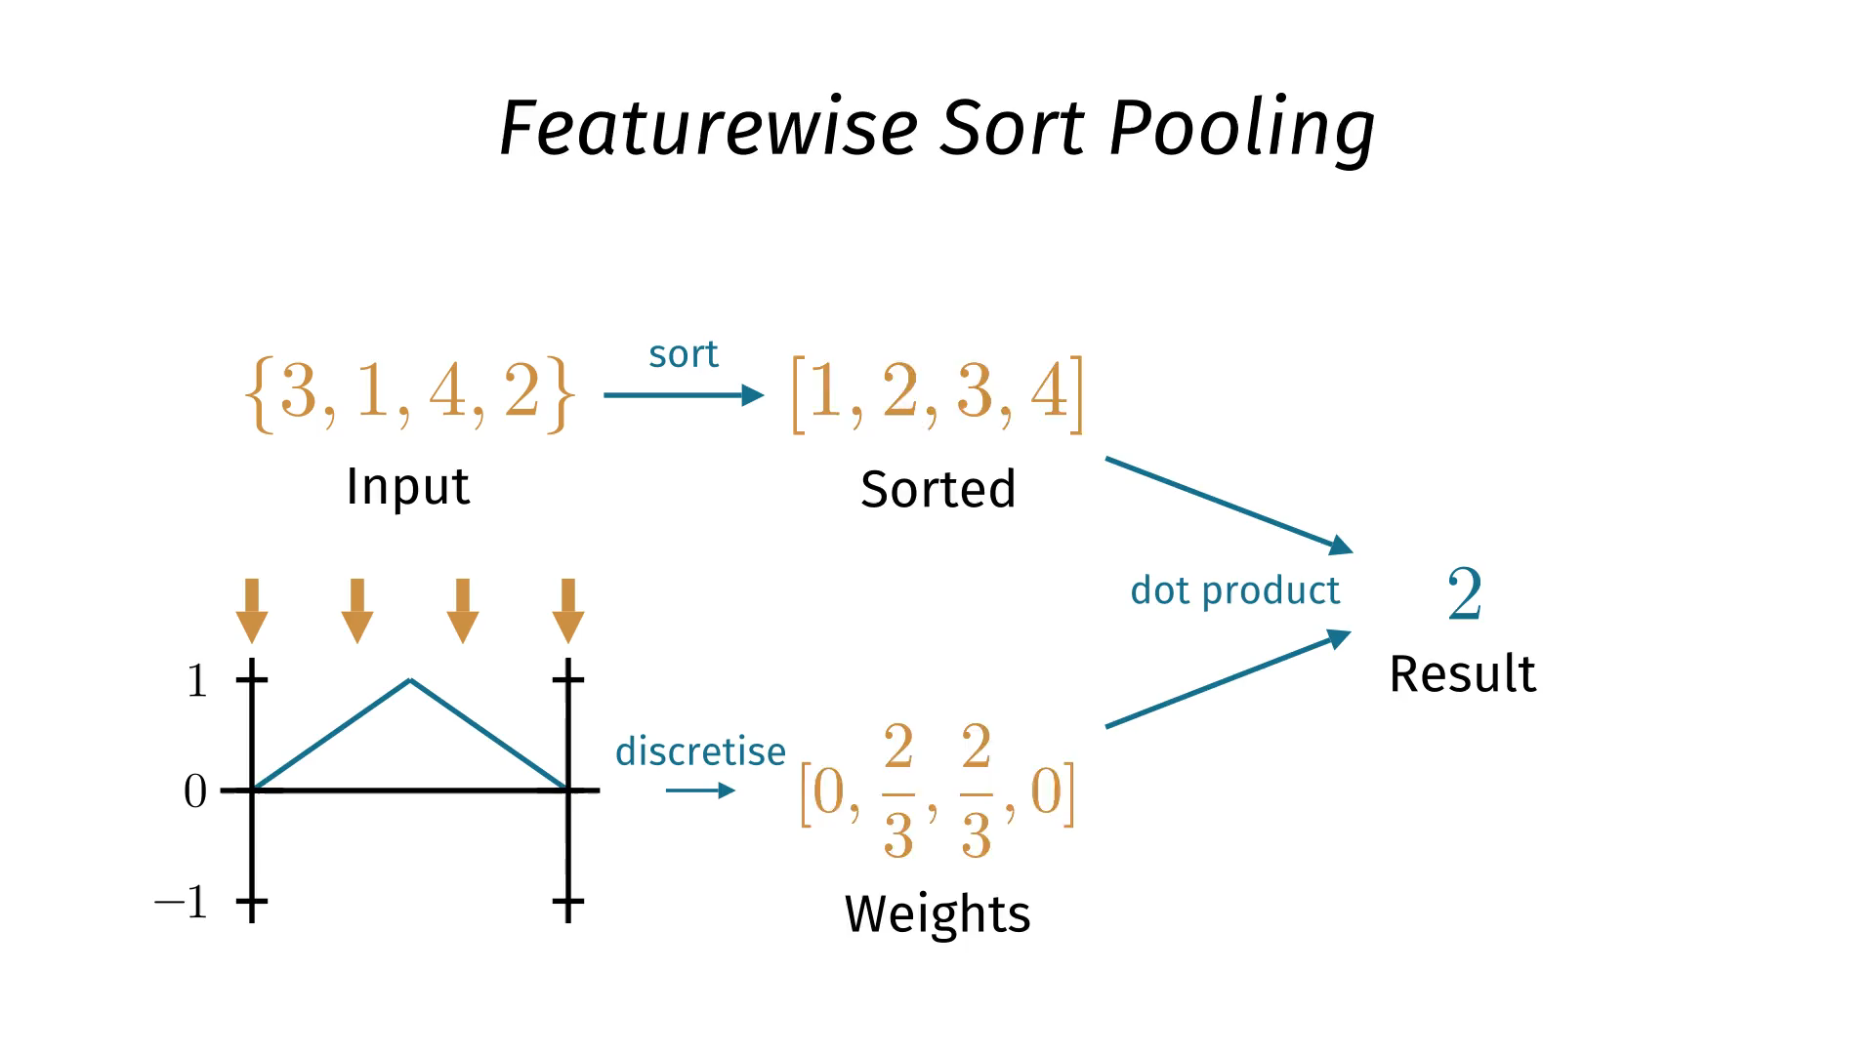

Slide 38
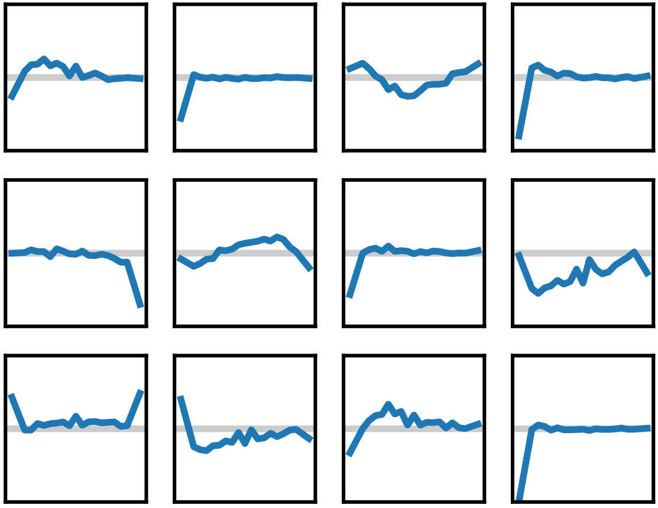
FSPool learned functions

Slide 39
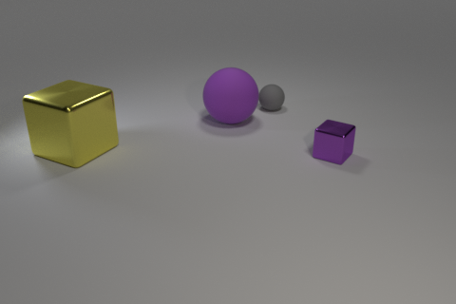
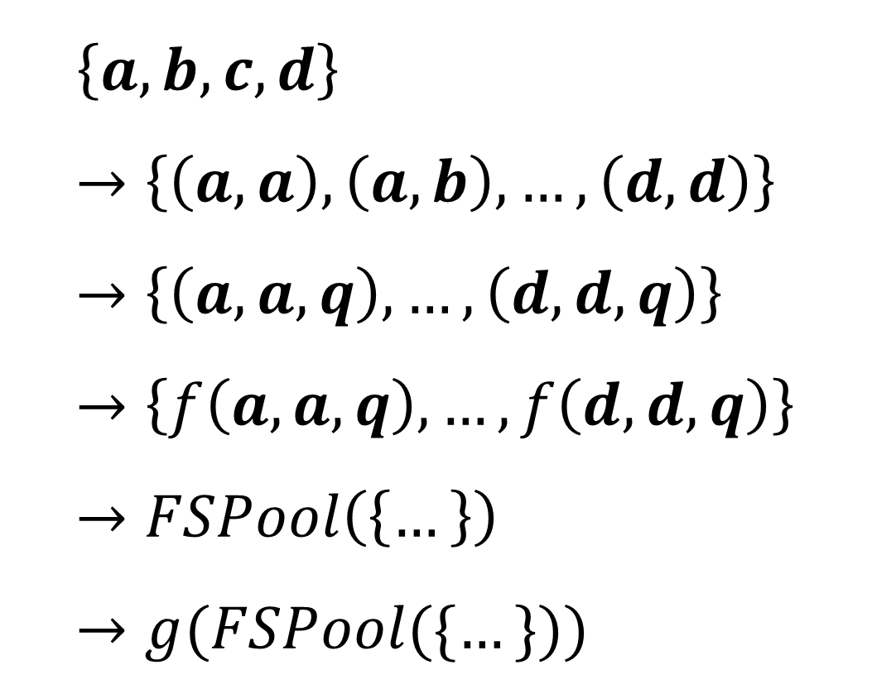
Example encoder on CLEVR
How many objects are left of the grey object?
$$\left\{a, b, c, d\right\} \\ →\left\{\left(a, a\right), \left(a, b\right), …, \left(d, d\right)\right\} \\ →\left\{\left(a, a, q\right), …, \left(d, d, q\right)\right\} \\ →\left\{f\left(a, a, q\right), …, f\left(d, d, q\right)\right\} \\ →FSPool\left(\left\{…\right\}\right) \\ →g(FSPool(\{…\}))$$
Relation Network
Concat question embedding
Elementwise MLP
Learned pooling
MLP classifier

Slide 40
Overview
Parts of this talk:
Set encoders: set → vector
Set decoders: vector → set

Slide 41
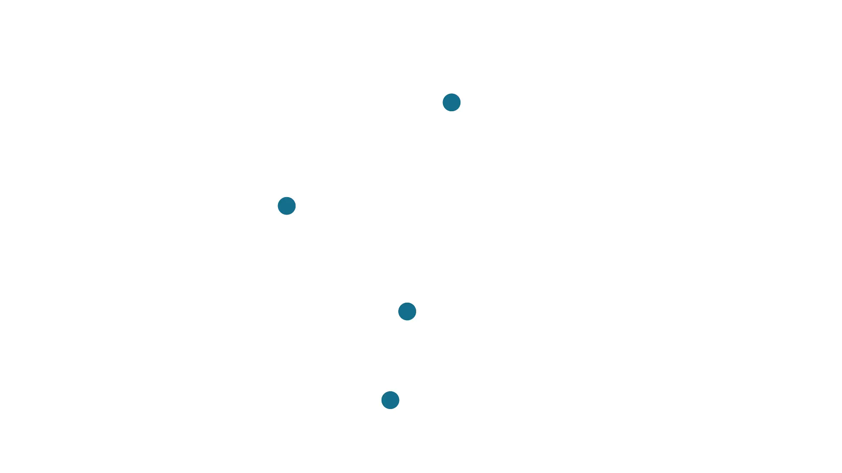
Set loss animation

Slide 42
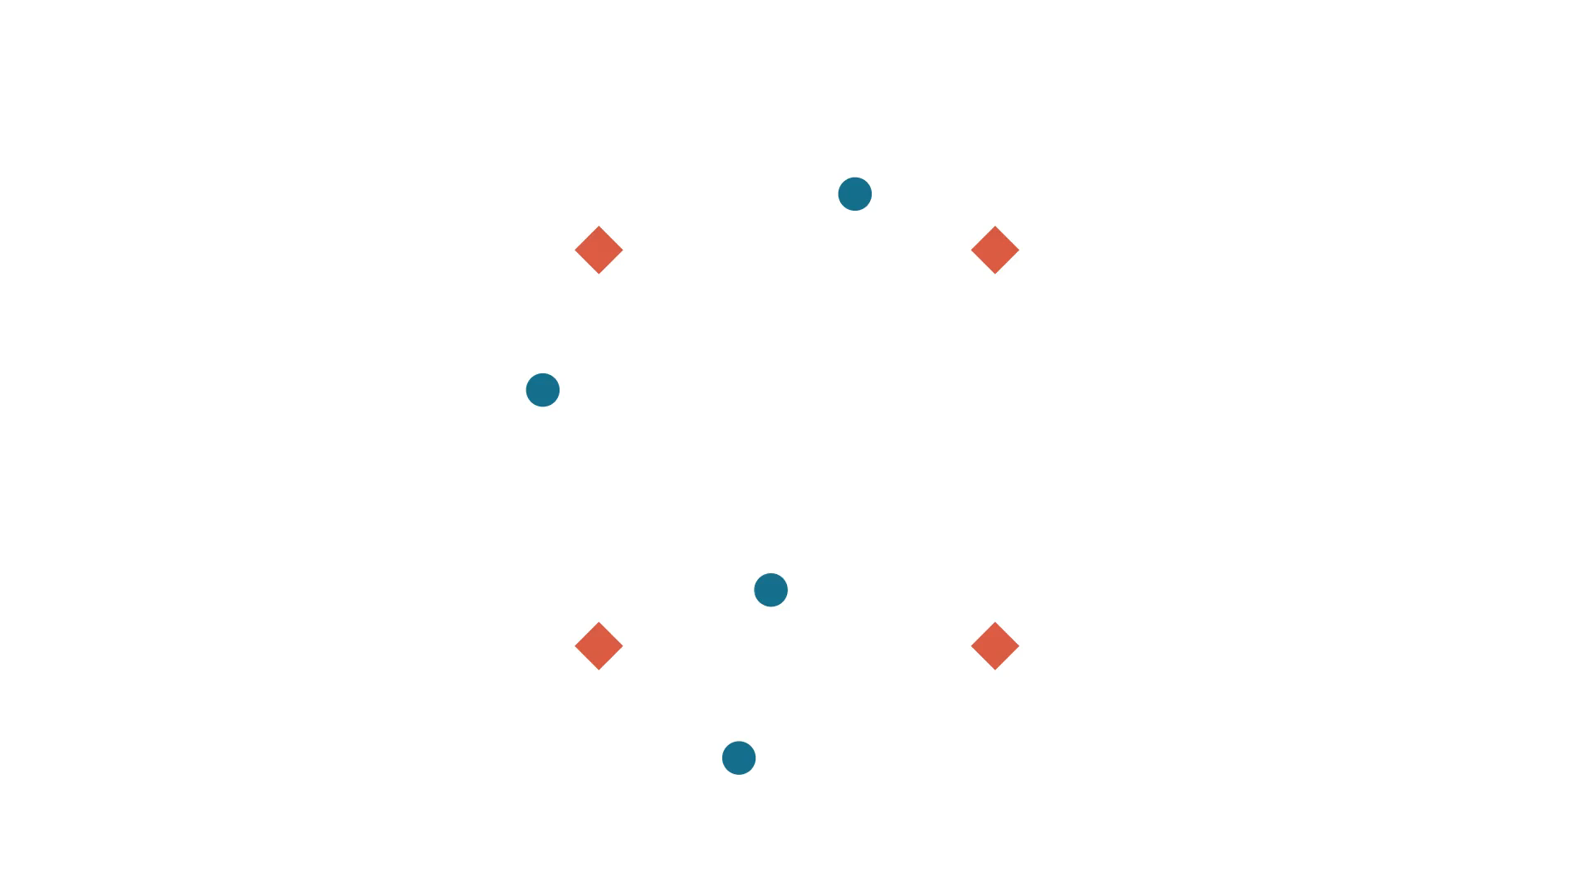

Slide 43
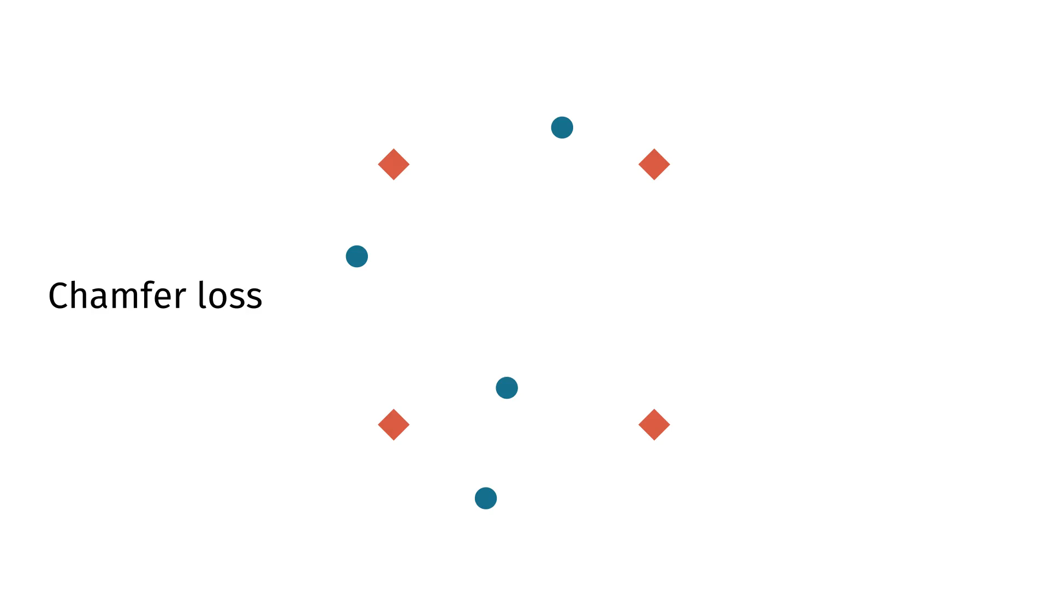

Slide 44
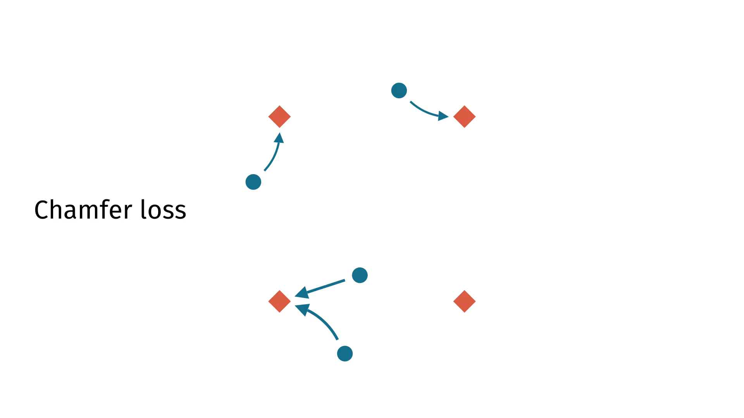

Slide 45
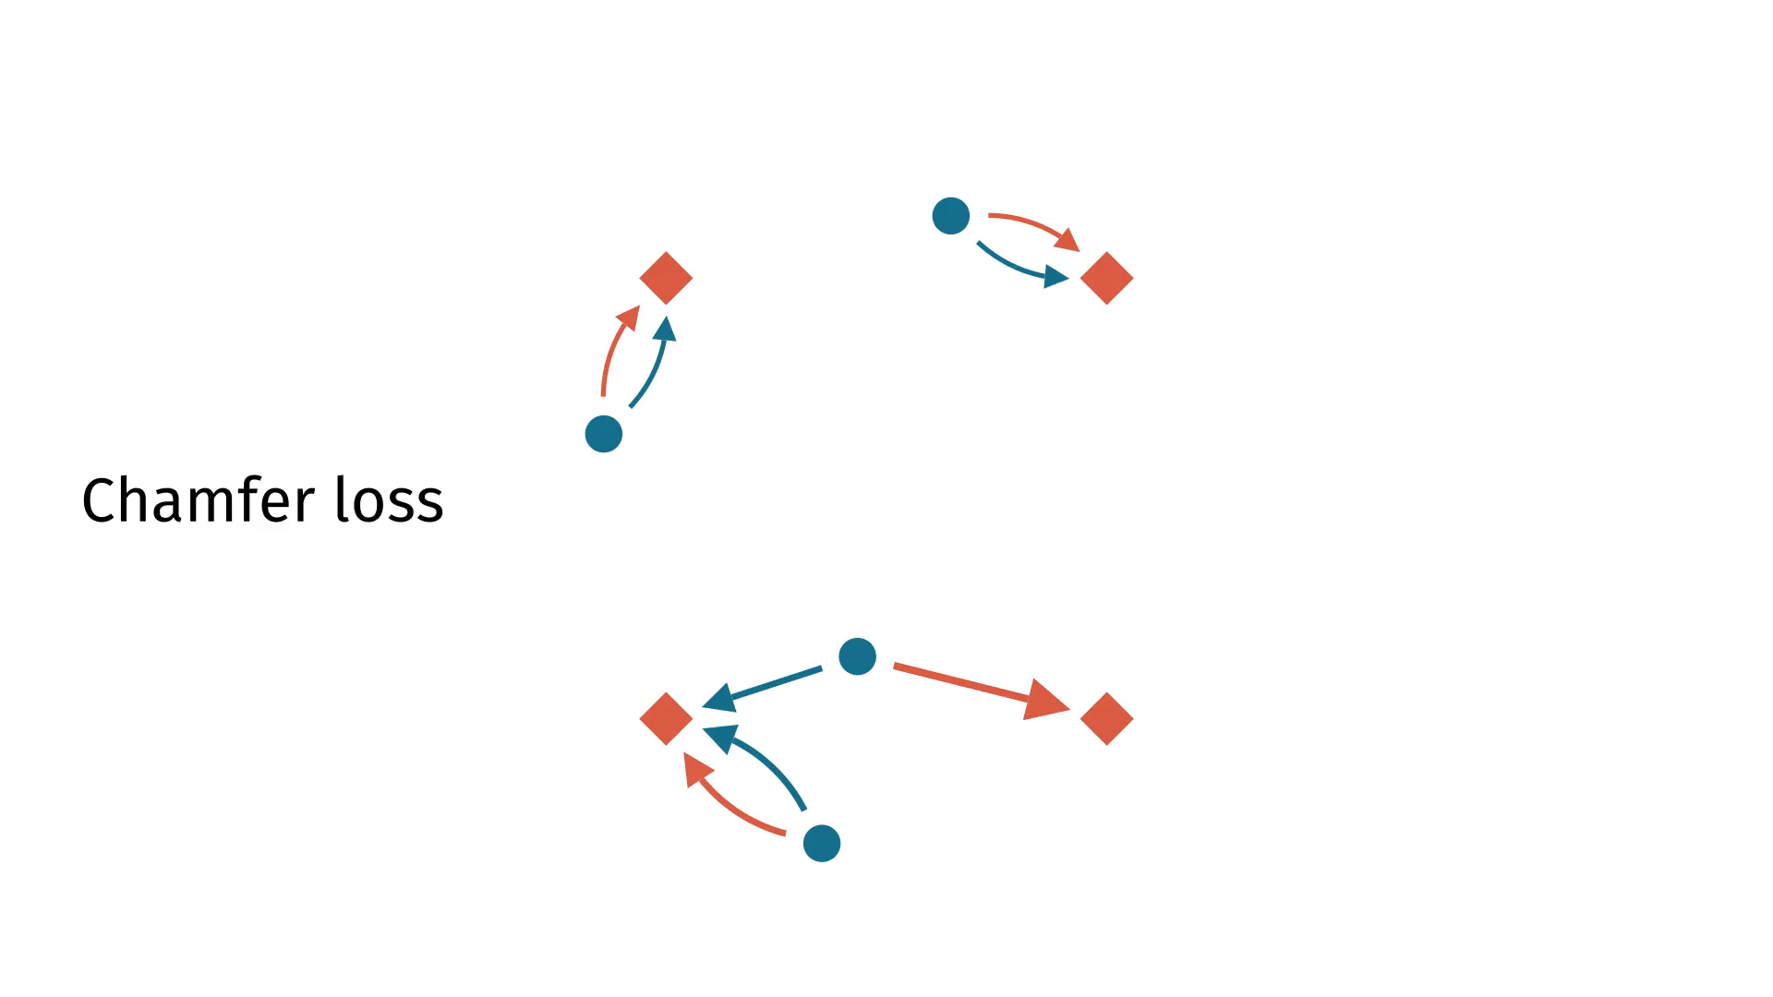

Slide 46
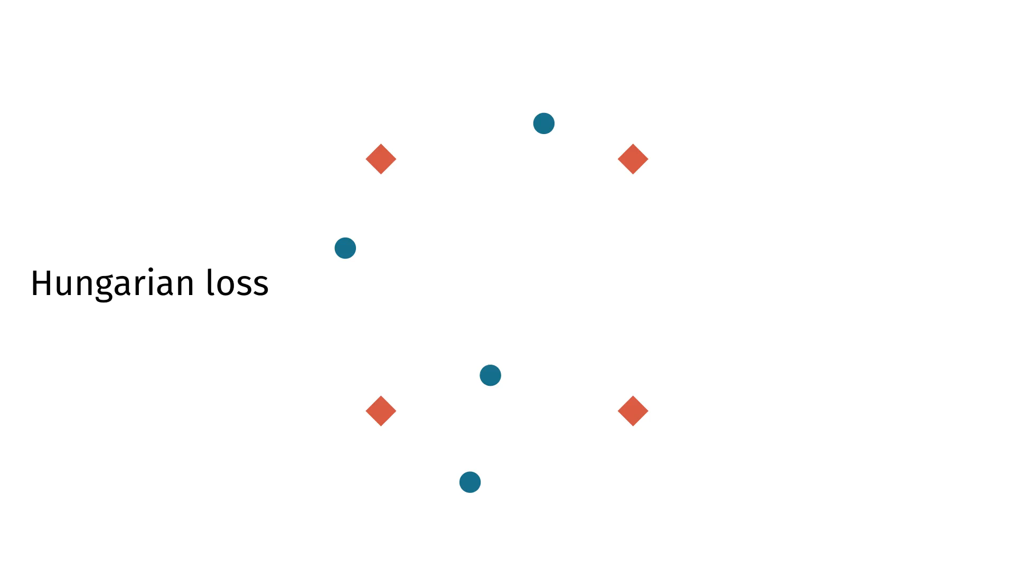

Slide 47
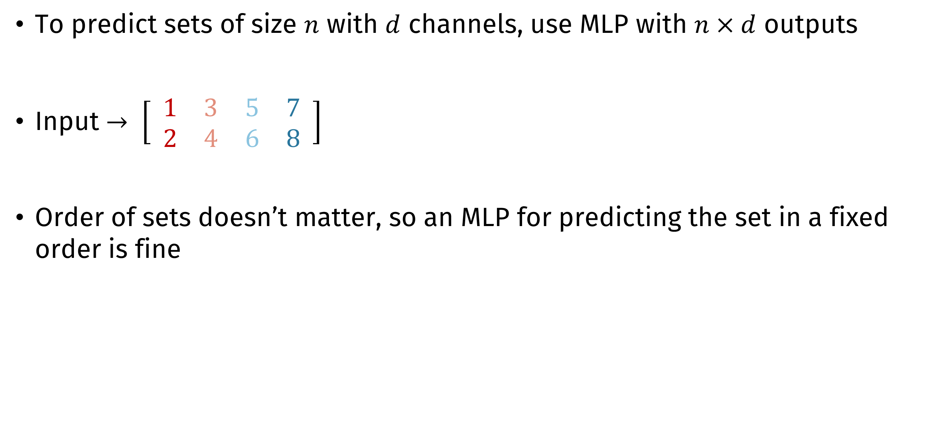
MLP as set decoder
To predict sets of size $n$ with $d$ channels, use MLP with $n×d$ outputs
Input $→ \left[\begin{matrix} 1 & 3 & 5 & 7 \\ 2 & 4 & 6 & 8 \end{matrix}\right]$
Order of sets doesn’t matter, so an MLP for predicting the set in a fixed order is fine
… right?

Slide 48
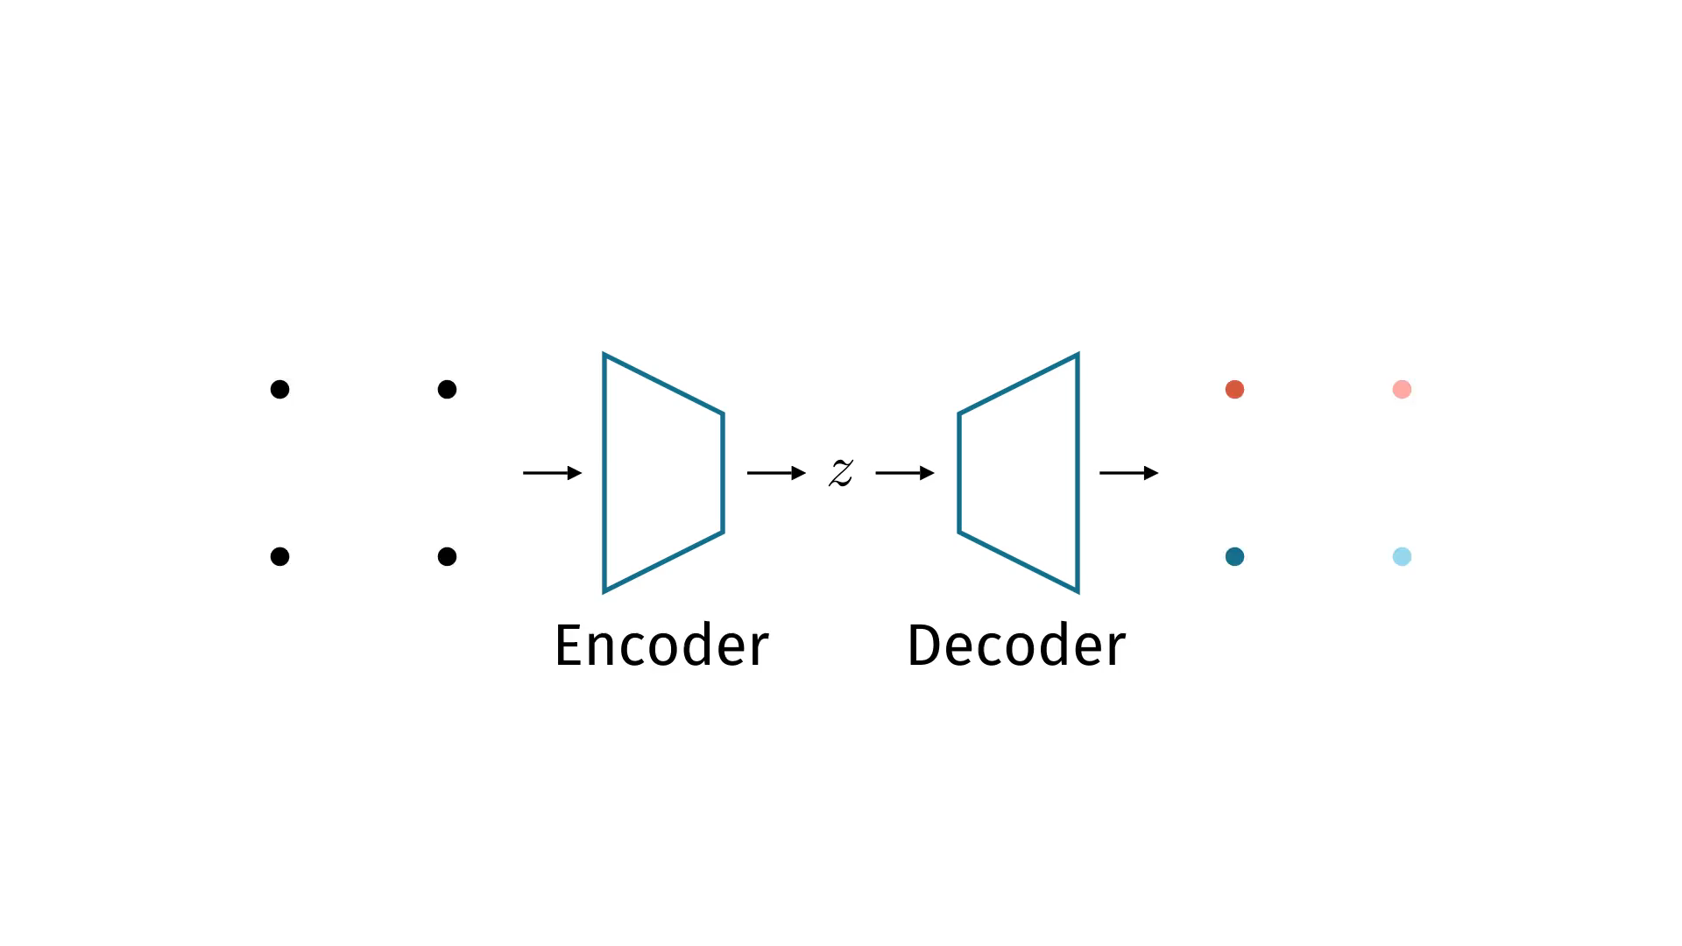
Responsibility animation

Slide 49


Slide 50
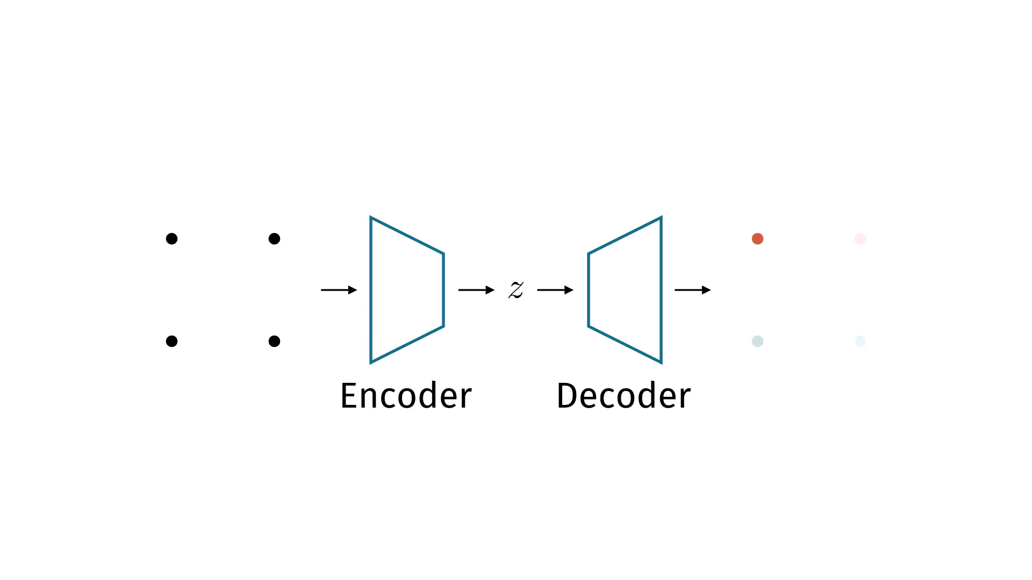

Slide 51


Slide 52
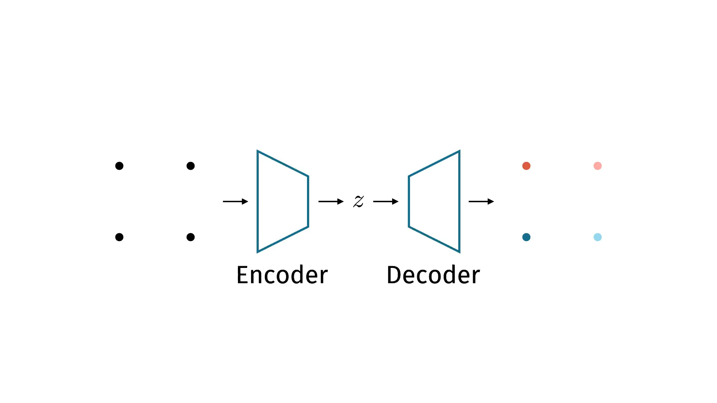

Slide 53
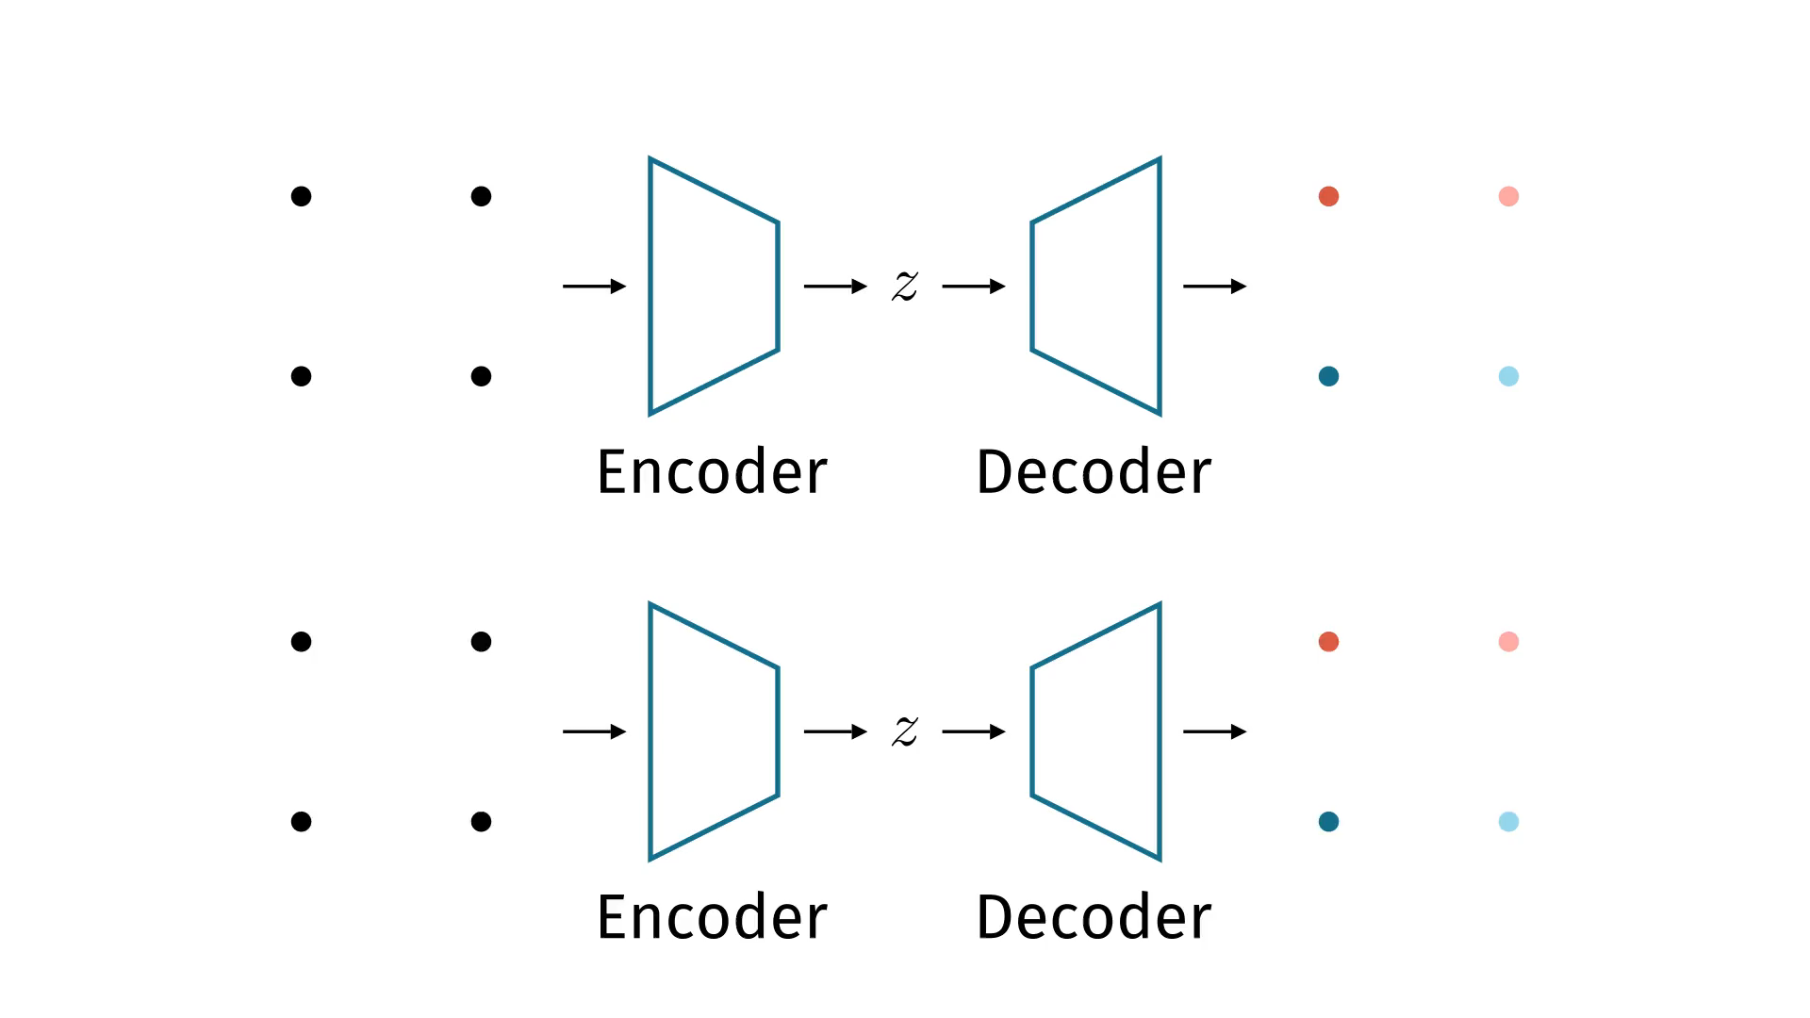

Slide 54


Slide 55
What went wrong?
MLP have ordered outputs, sets are unordered
Result: discontinuity and sadness
Don’t ignore the structure of the problem!
Need a model that has unordered outputs

Slide 56
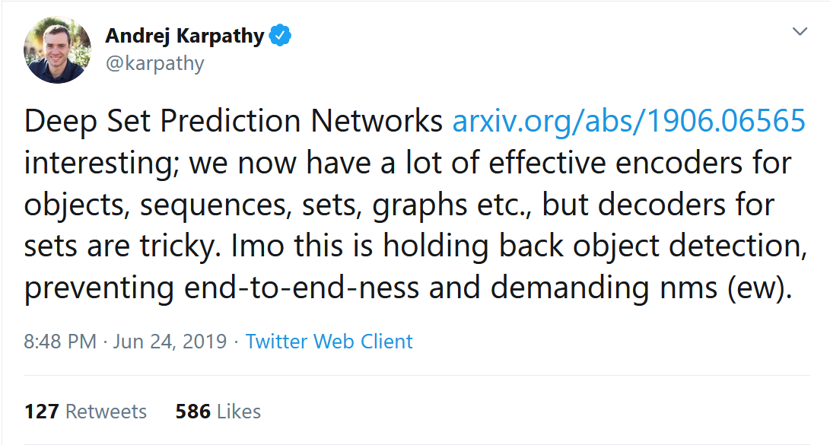
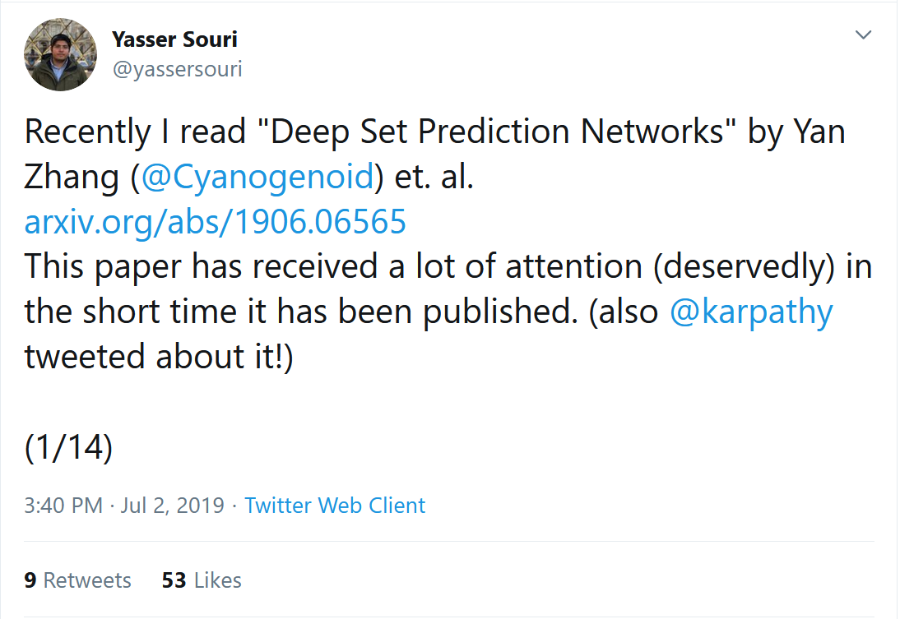
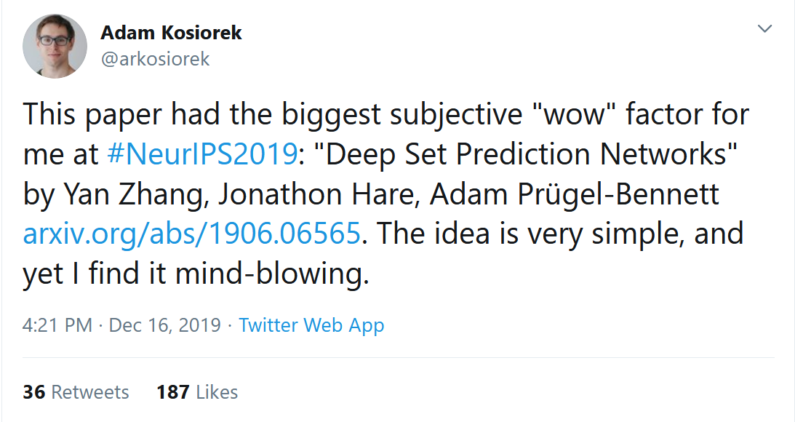
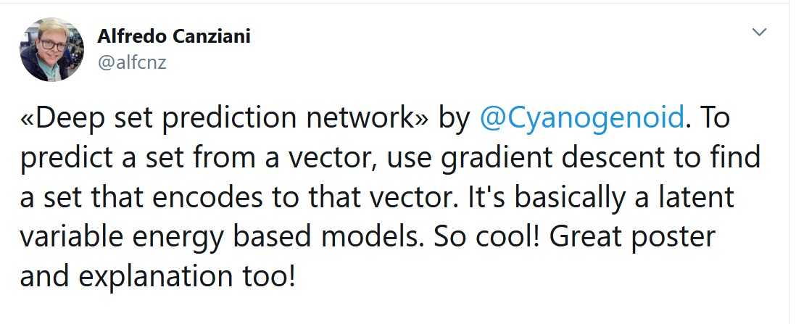

Slide 57
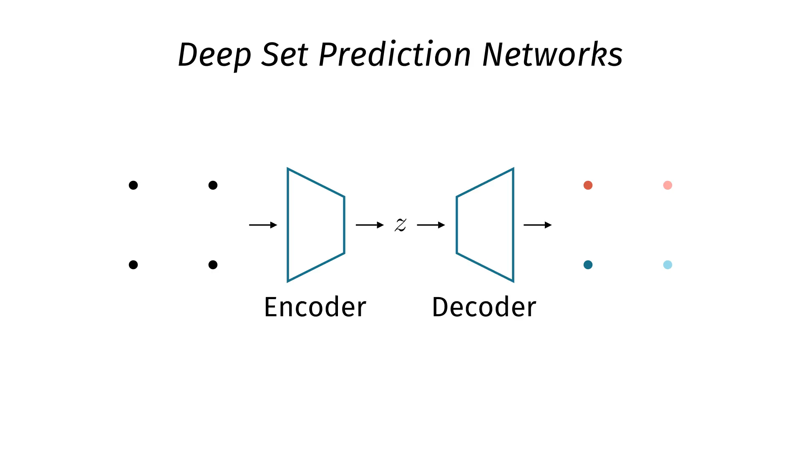

Slide 58
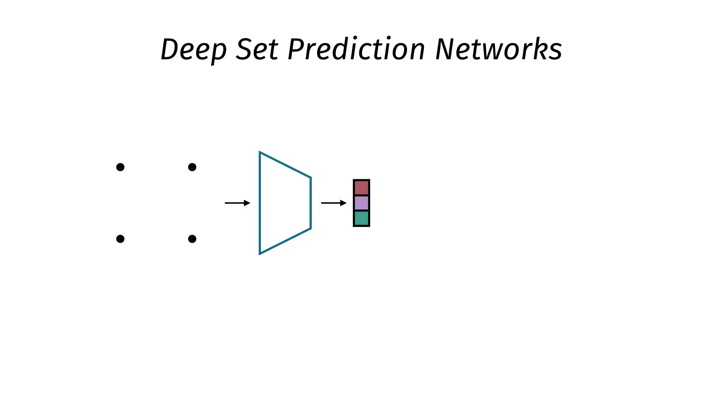

Slide 59
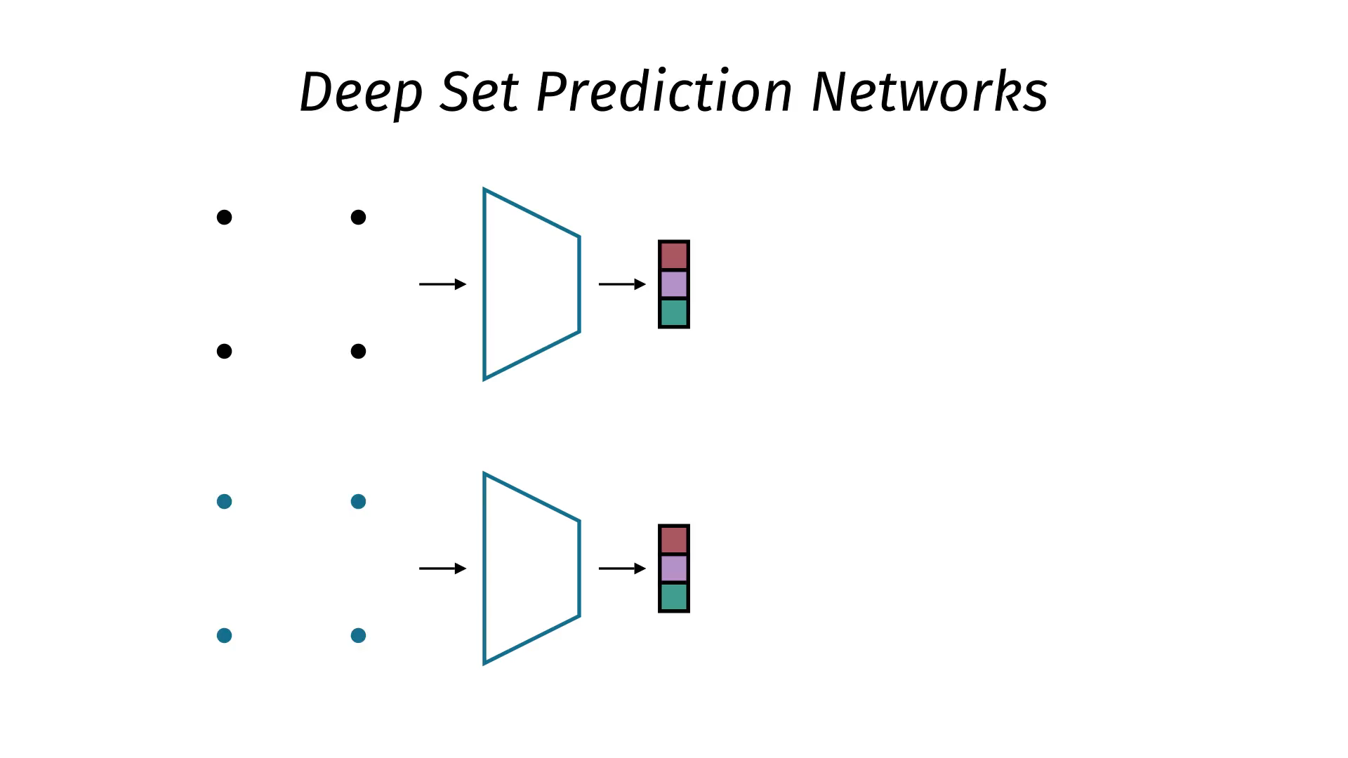

Slide 60
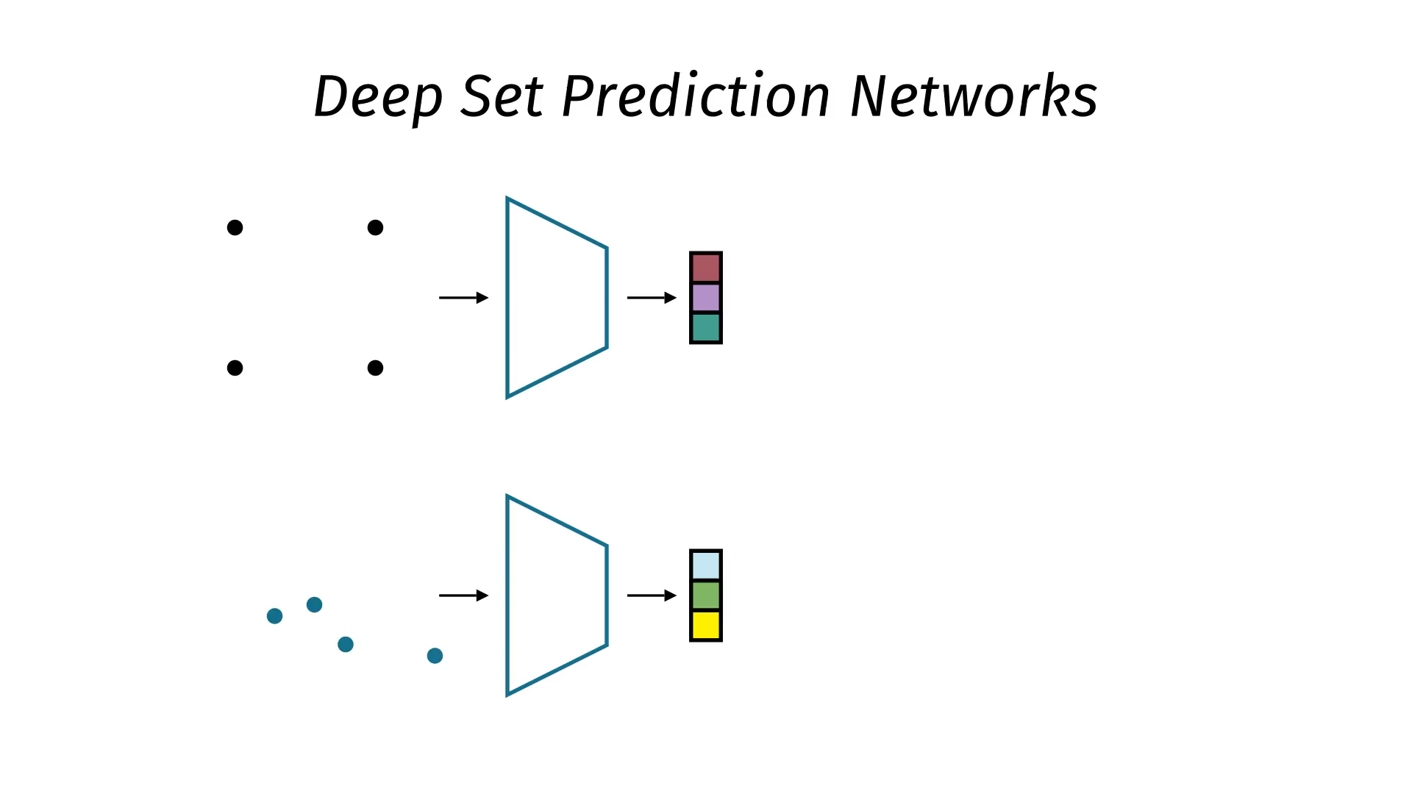

Slide 61
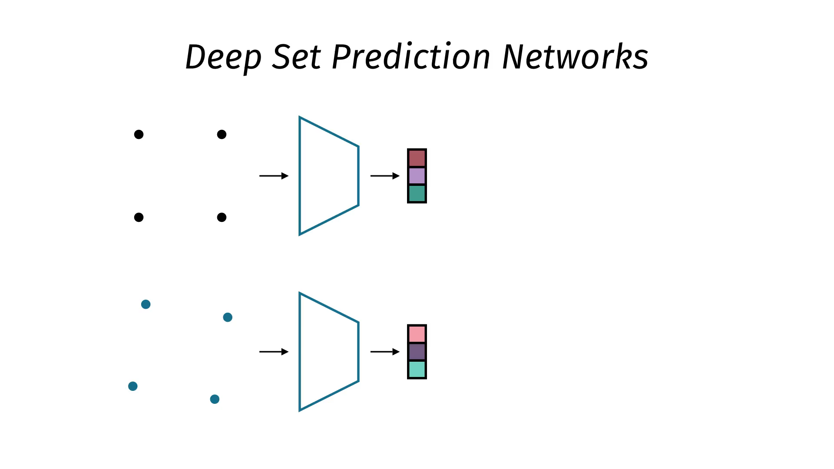

Slide 63


Slide 64


Slide 65


Slide 66


Slide 67


Slide 68


Slide 69


Slide 70


Slide 71


Slide 72

CLEVR bbox animation

Slide 73

CLEVR state animation
Not started

Slide 74
How is this different?
Set encoder is permutation-invariant
➔ Gradient wrt input is permutation-equivariant
➔ Gradient descent on MSE is completely permutation-equivariant
Prediction is unordered, exactly what we wanted!
Algorithm properly models the orderless nature of sets
Notes:
- Does better than MLP and RNN to predict the set

Slide 75
Lessons learned
How to build set encoders and decoders
Set properties: permutation invariance and equivariance
Differentiable structures allow end-to-end training
Don’t ignore the structure in your data, work with it

Slide 76
References
My PhD thesis: cyanogenoid.com/files/thesis.pdf
Featurewise Sort Pooling & Responsibility Problem, Zhang et al. 2020 arxiv.org/abs/1906.02795
Deep Set Prediction Networks, Zhang et al. 2019 arxiv.org/abs/1906.06565
Deep Sets, Zaheer et al. 2017 arxiv.org/abs/1703.06114
Relation Networks, Santoro et al. 2017 arxiv.org/abs/1706.01427
Janossy Pooling, Murphy et al. 2018 arxiv.org/abs/1811.01900
Learning Representations and Generative Models for 3D Point Clouds, Achlioptas et al. 2018 arxiv.org/abs/1707.02392
Slides: cyanogenoid.com/files/london-meetup-2020-02-19.pptx
Animation engine: github.com/3b1b/manim
Car SVG icon in the intro animation made by Freepik from www.flaticon.com

Slide 77
Slides: cyanogenoid.com/files/london-meetup-2020-02-19.pptx
I finished my PhD,
I’m looking for a research job.
cyanogenoid@gmail.com

